Slide 2
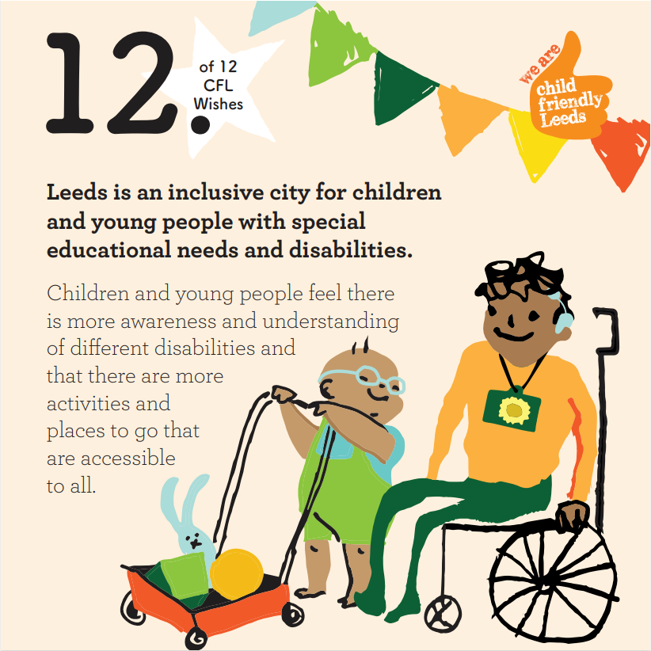
Child Friendly Leeds
Wish 12
Notes:
Have you seen the Child Friendly Leeds thumb before? It shows that the person/place/organisation is supporting children and young people and wants to make the city the best place to grow up in.
There are 12 wishes that the Child Friendly Leeds team (a small team within the council) work on. These wishes are from the voices and ideas of 80,000 children and young people, and this is the twelfth wish. Read it out.

Slide 3
What different disabilities have you heard of?
Notes:
Ask 3-5 children what disabilities they've heard of. You can potentially give time for partner discussion.

Slide 4
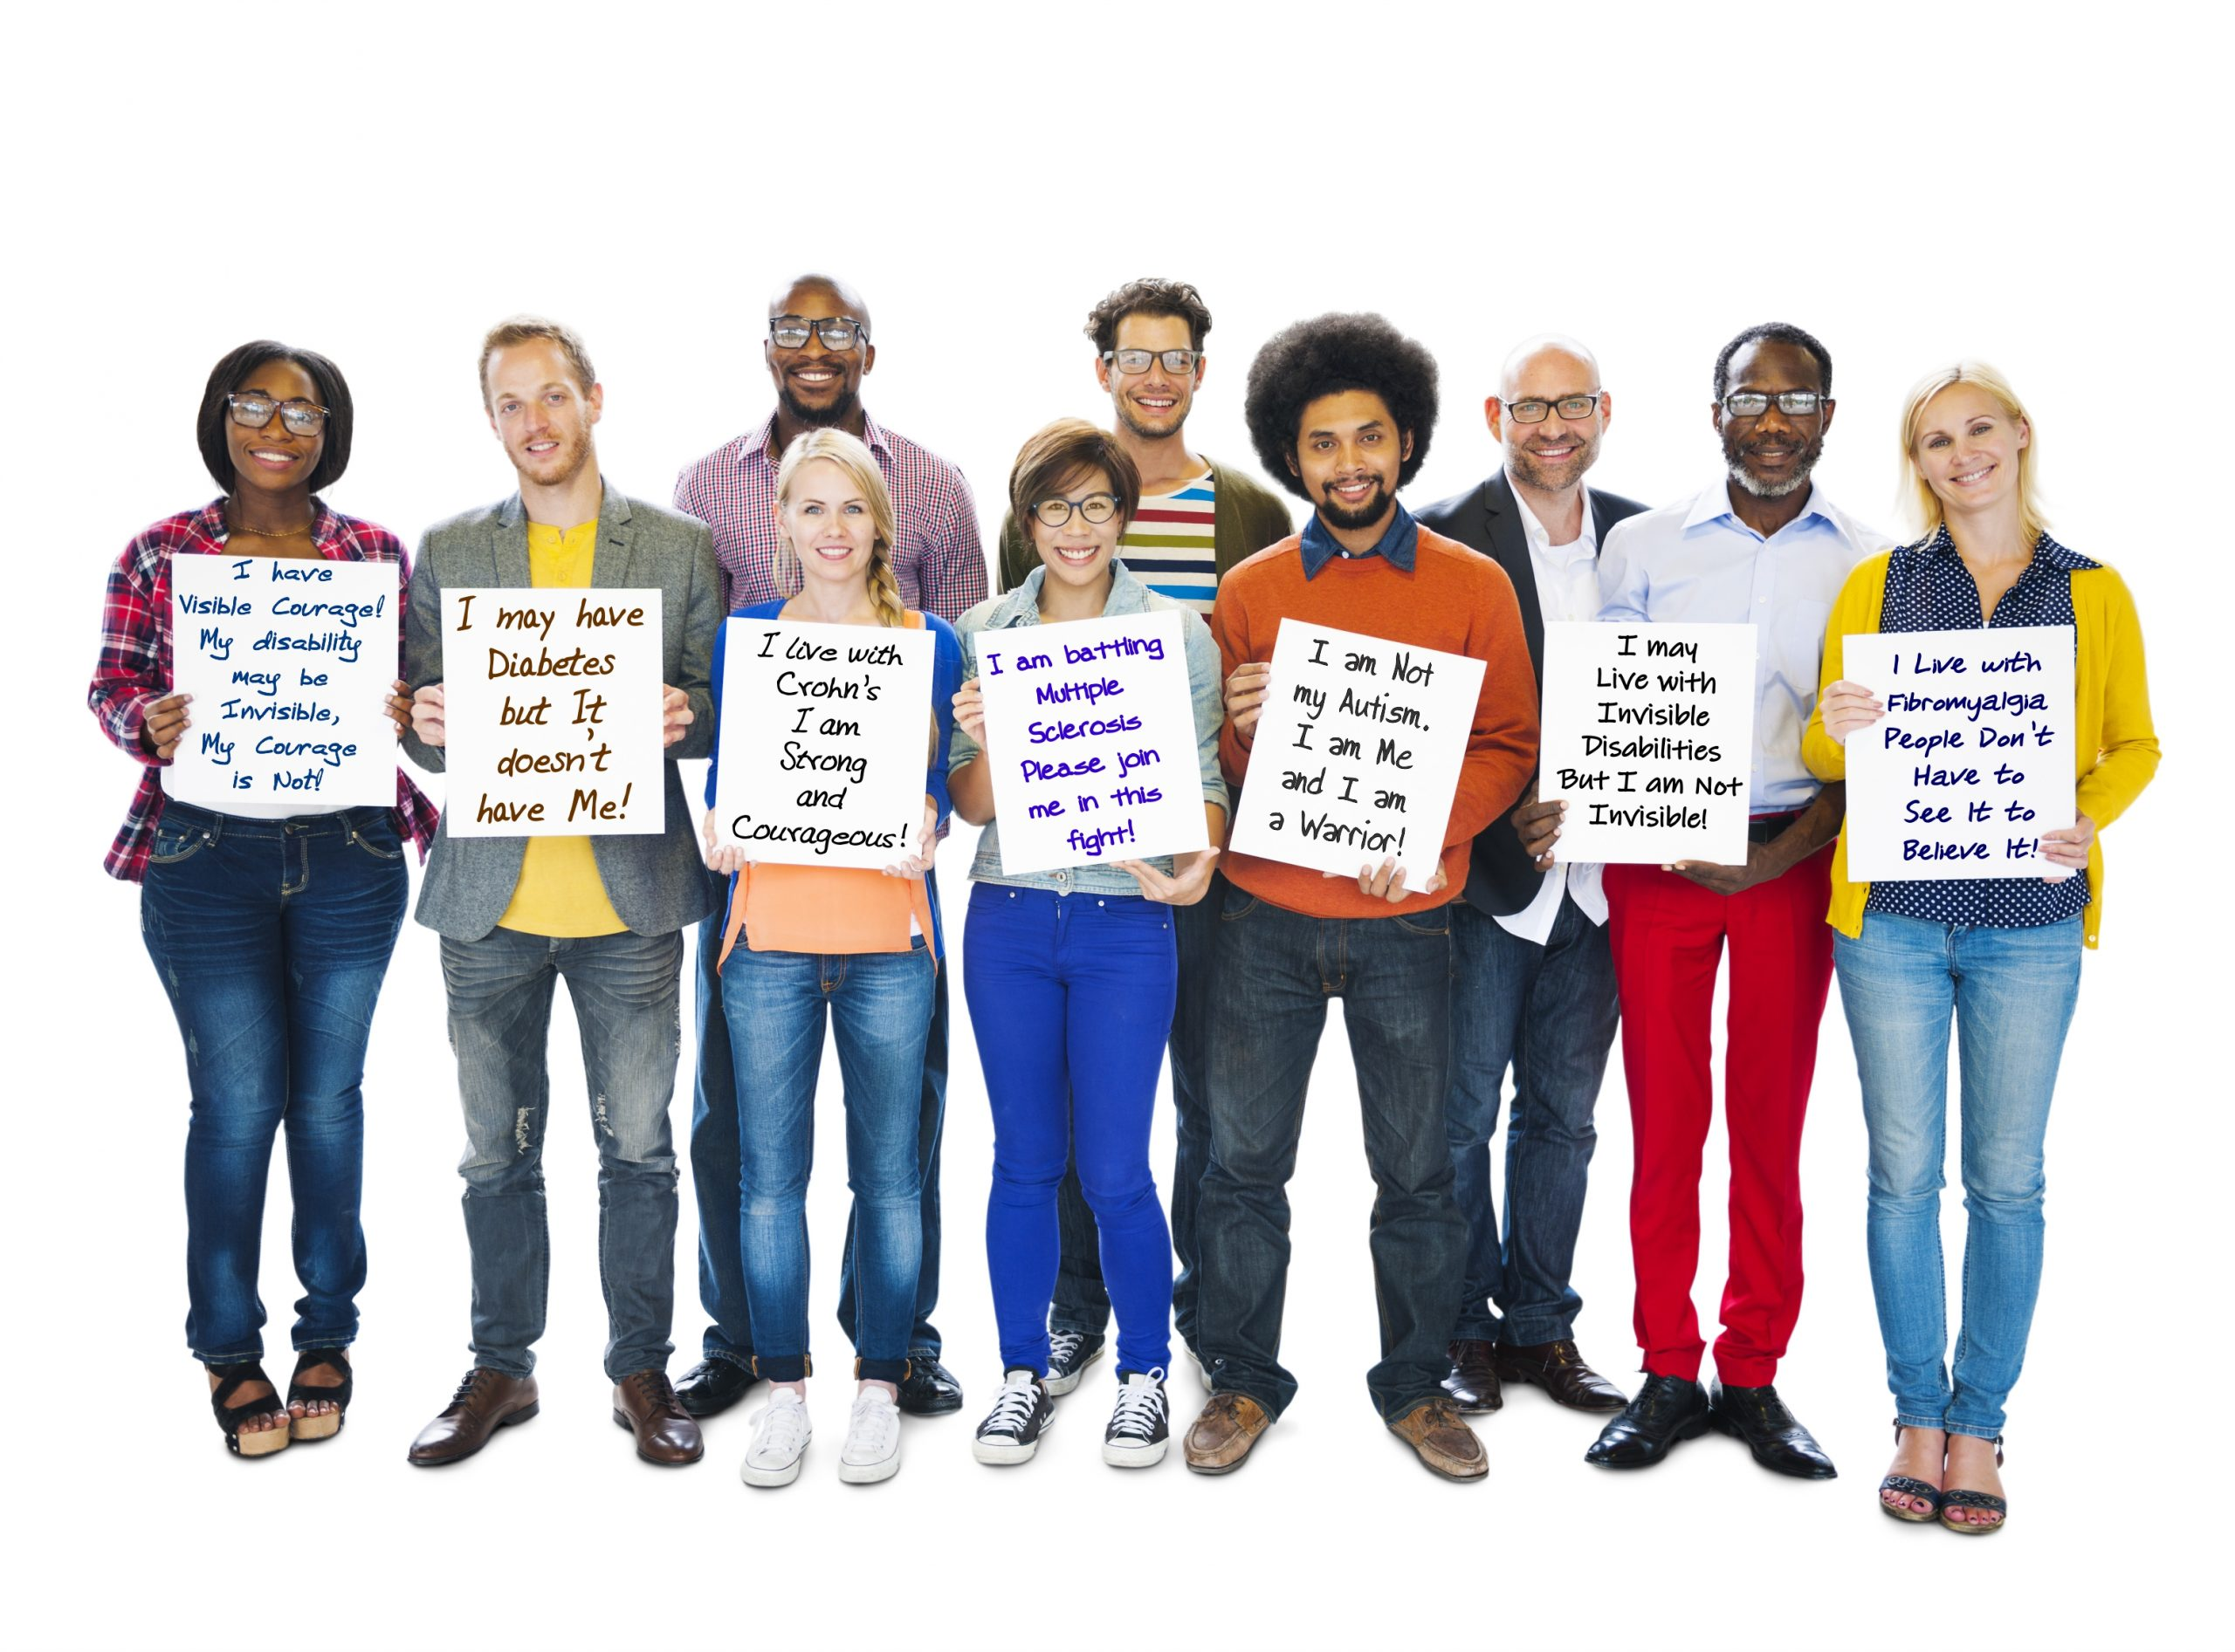
These people all have 'hidden' disabilities…
Notes:
These people all have hidden disabilities like diabetes and Chron's. These people might have symptoms that can impact their life, but they might not look like our first idea of a 'disabled' person.
For example, someone with diabetes might have to be very careful about their diet, so they might not be able to share food in class and would have to take extra care on a school trip, to make sure they have the right medical equipment. Though they may not 'look' disabled, they are facing extra barriers in life.

Slide 5
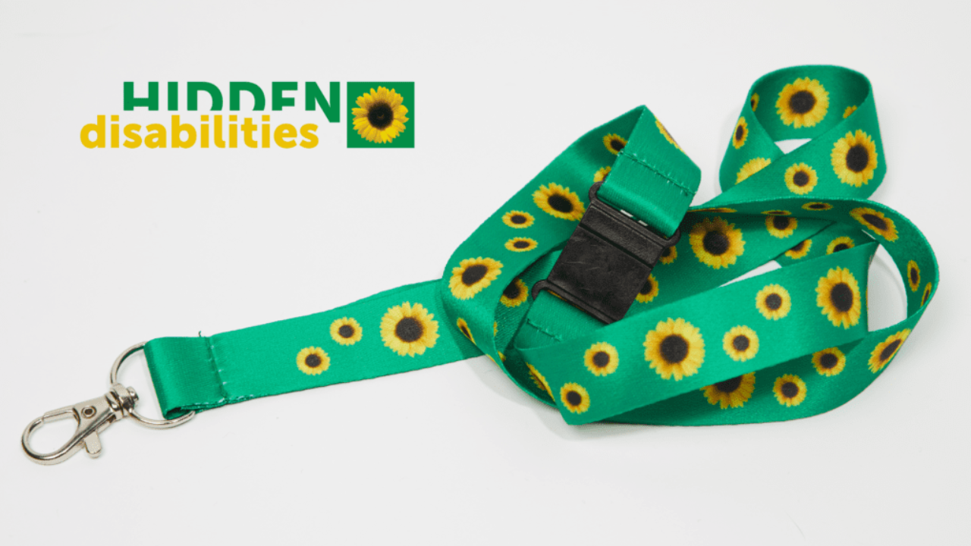
Notes:
Who has heard of the hidden sunflower lanyards? Keep your hand up if you know why someone would wear it?

Slide 6
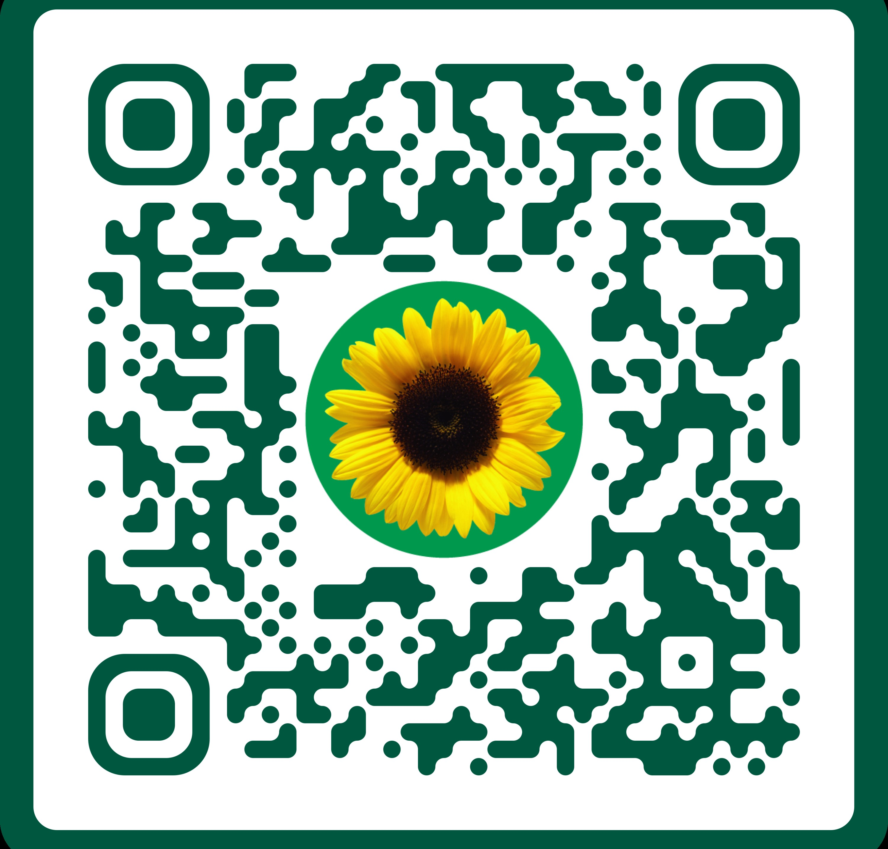
hdsunflower.com
Notes:
It is a simple tool to voluntarily share that you have a non-visible disability. Simply by wearing the Sunflower, you’re just letting everyone know that you might need extra help, understanding, or just more time.
The Sunflower is recognised in many sectors ranging from retail, travel and tourism, transport including over 240 airports in over 30 countries - as well as railway networks, coach and bus services and ferries, education (universities, schools and colleges), healthcare, central and local government agencies to football teams, theme parks, theatres and financial institutions.

Slide 7
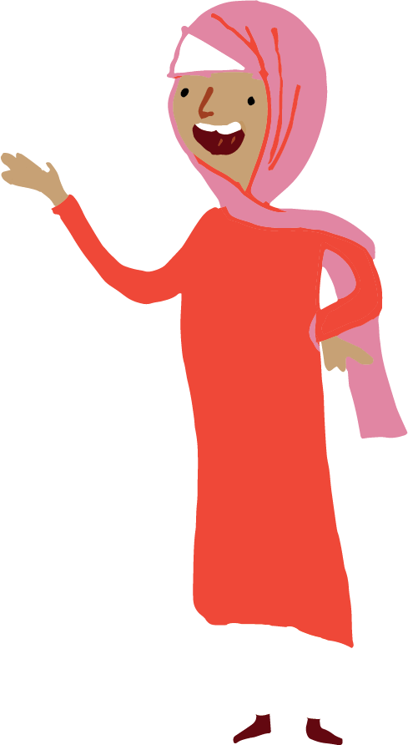
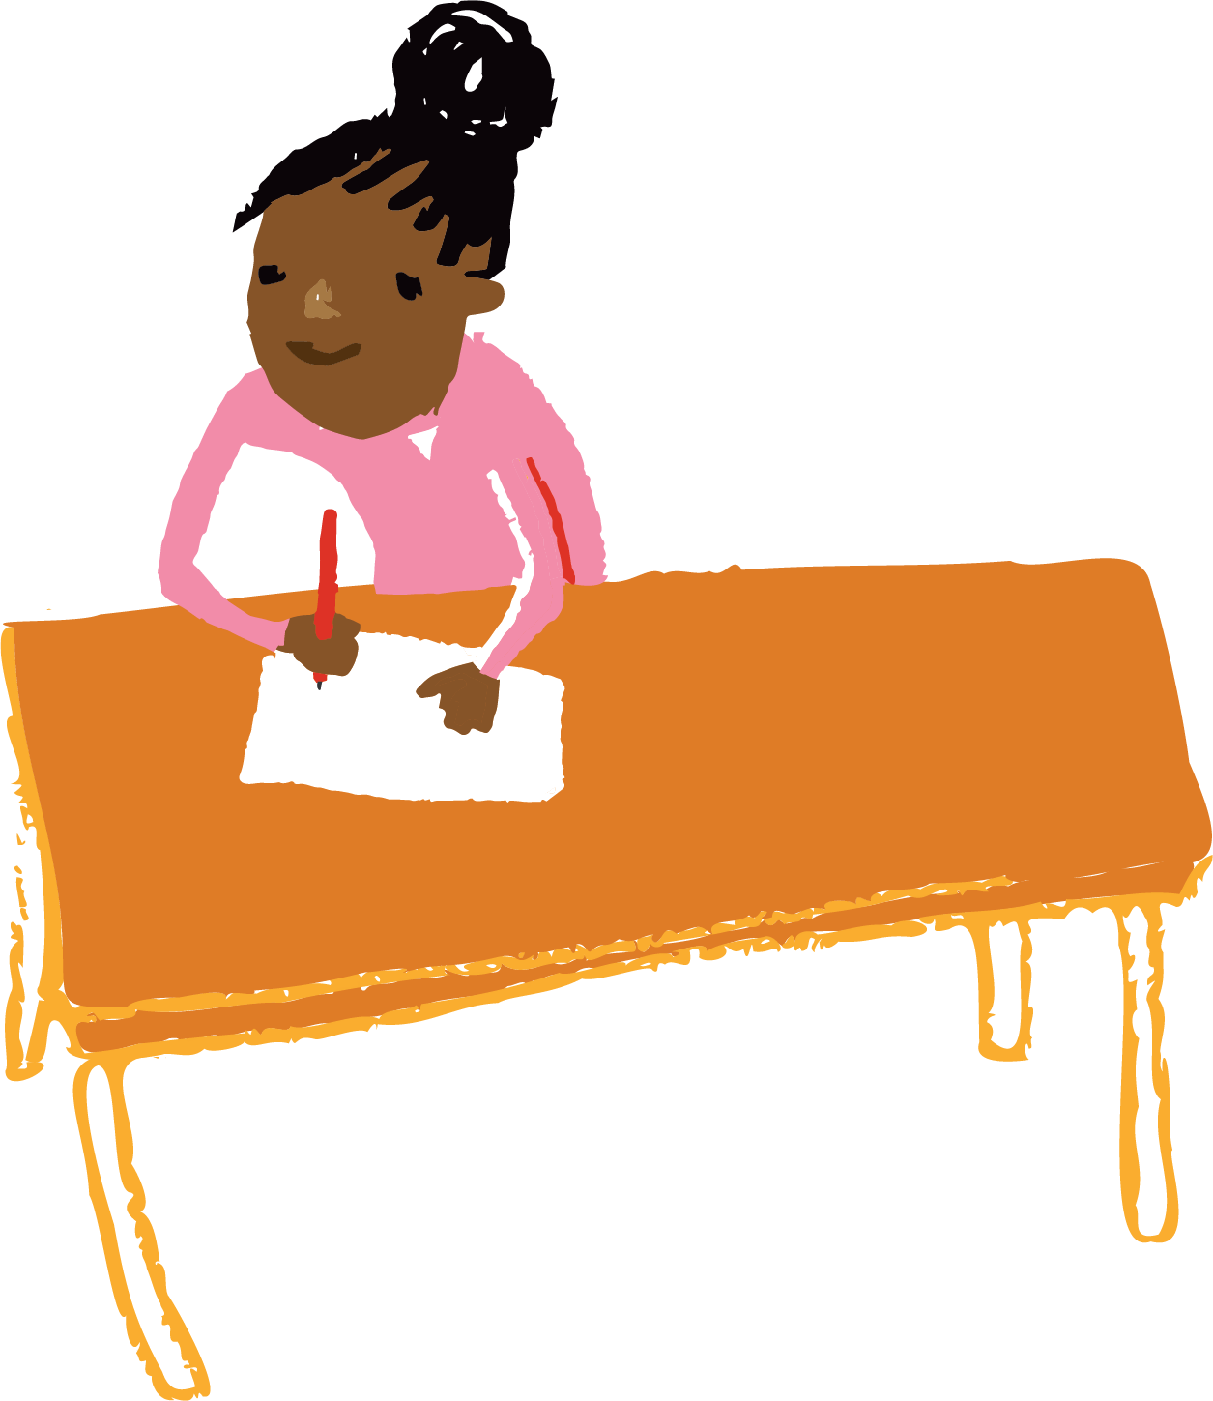
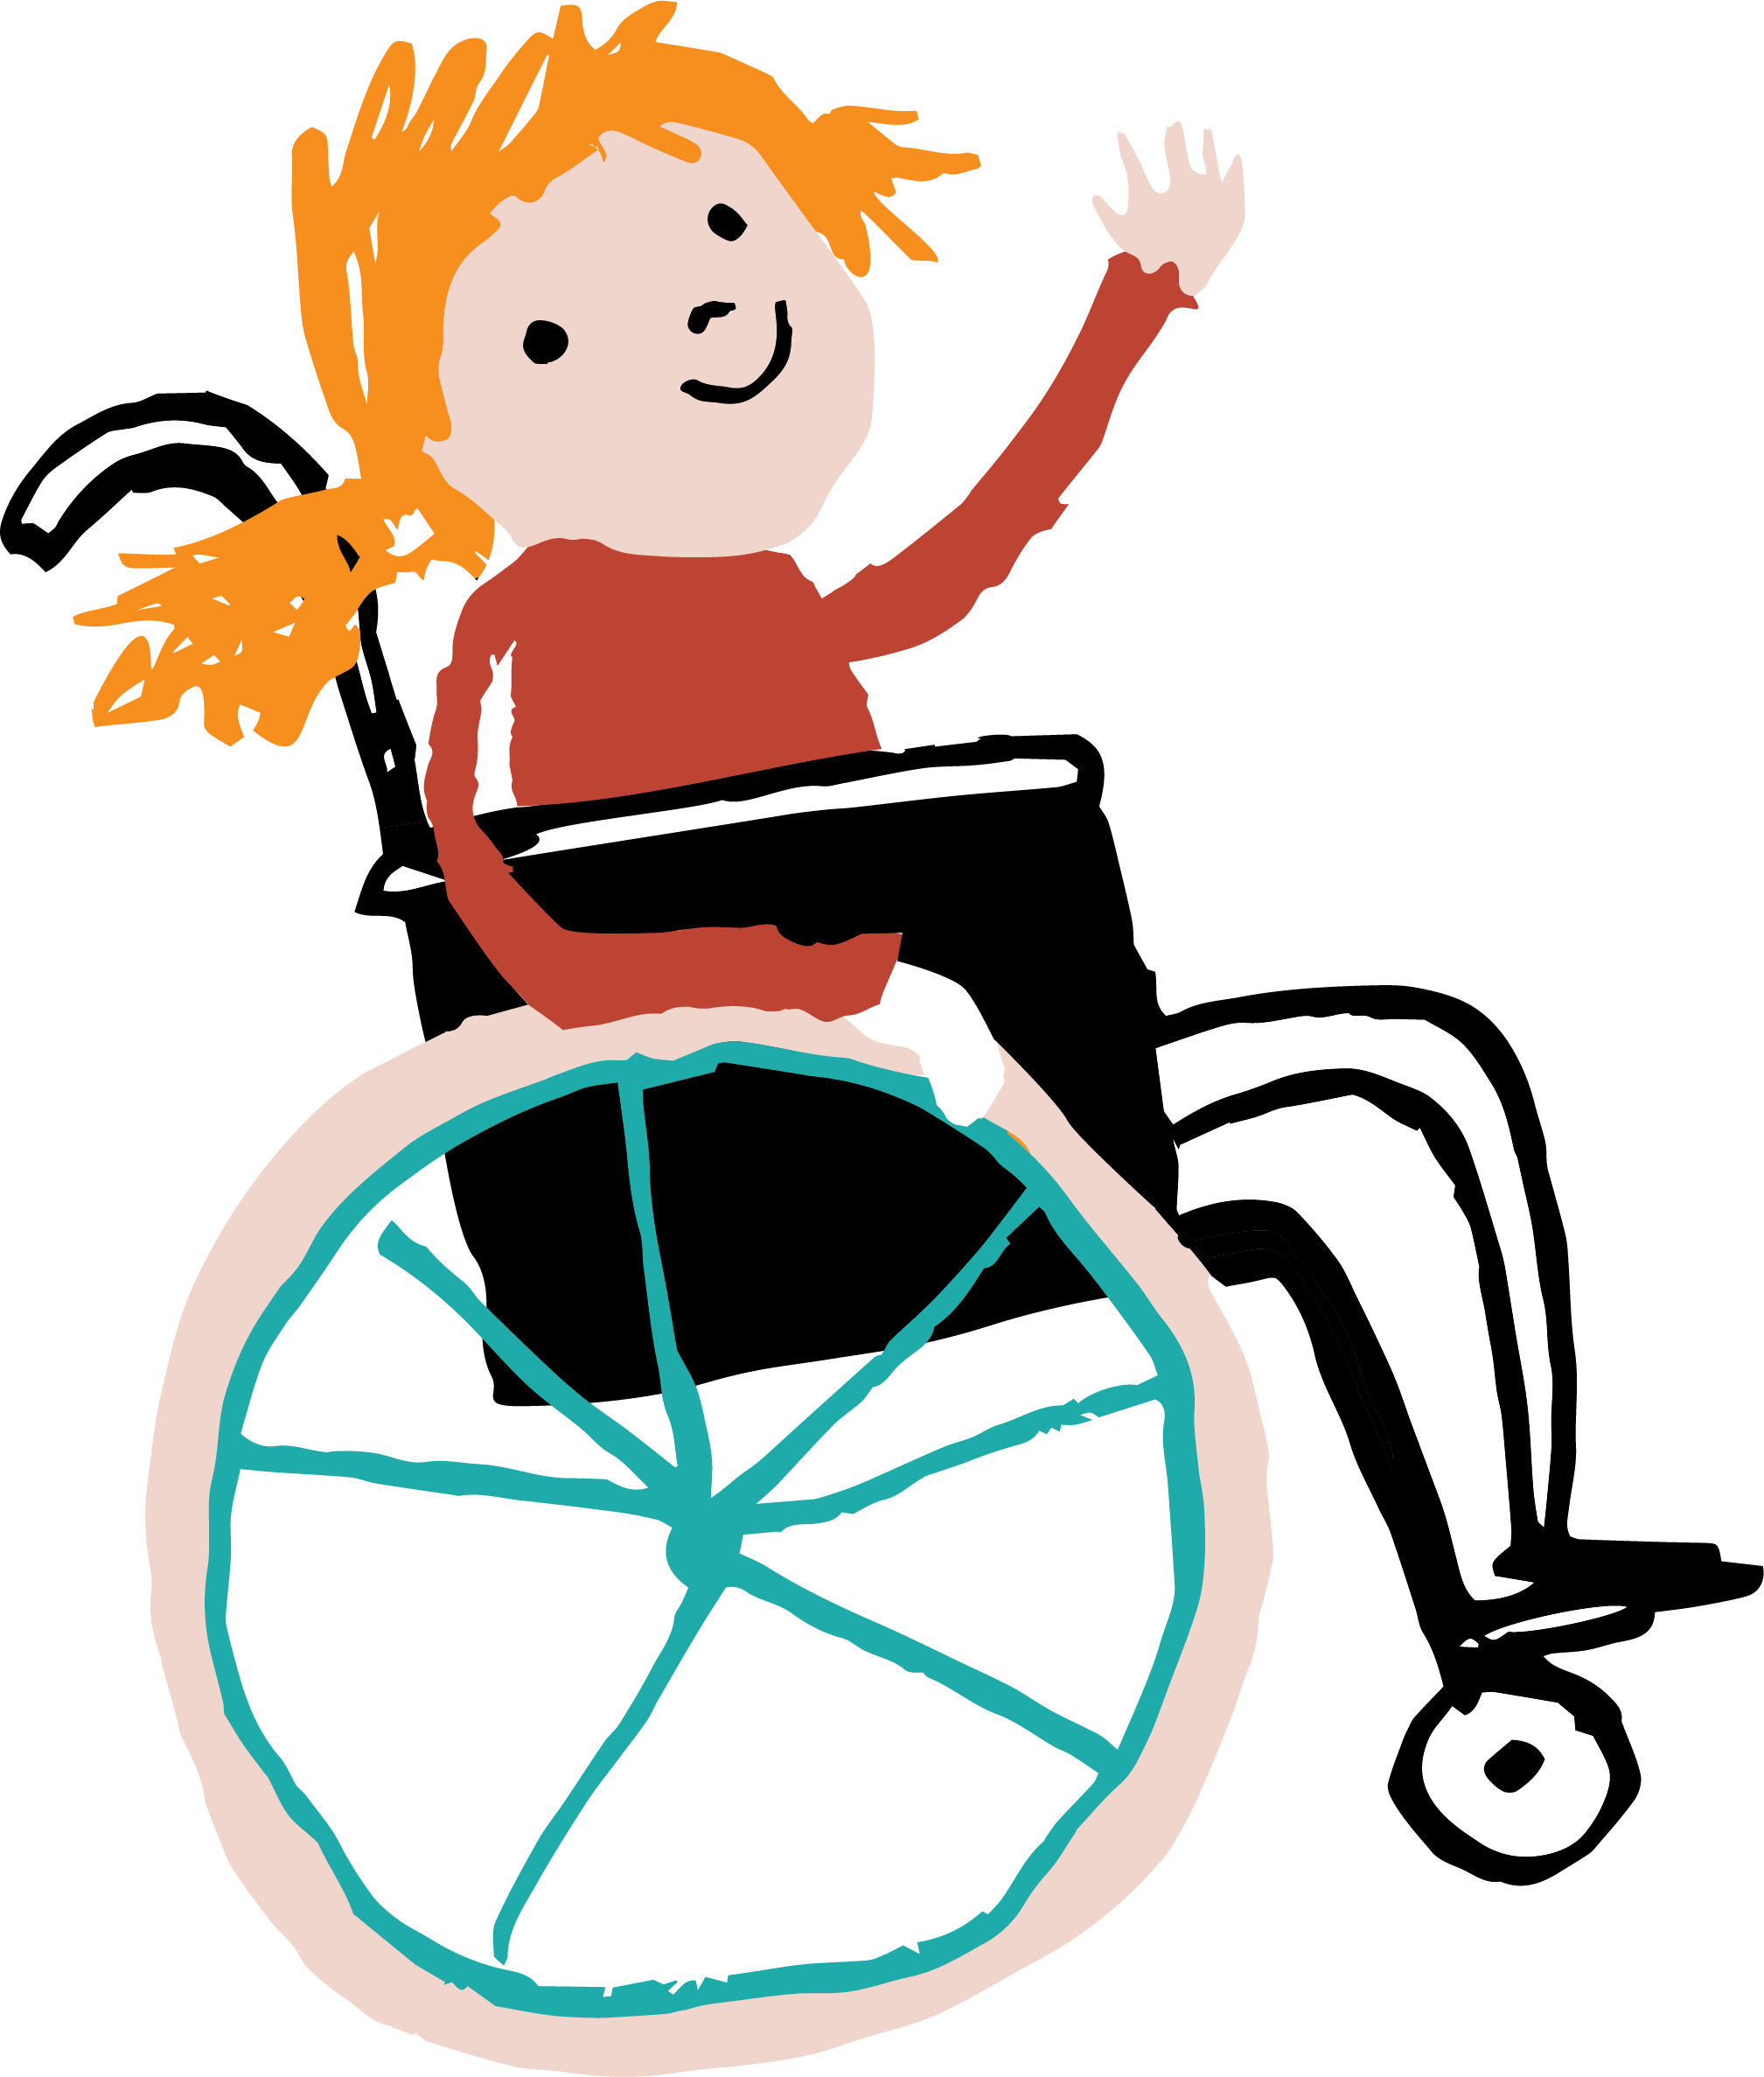
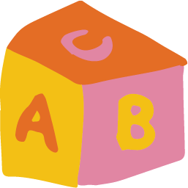
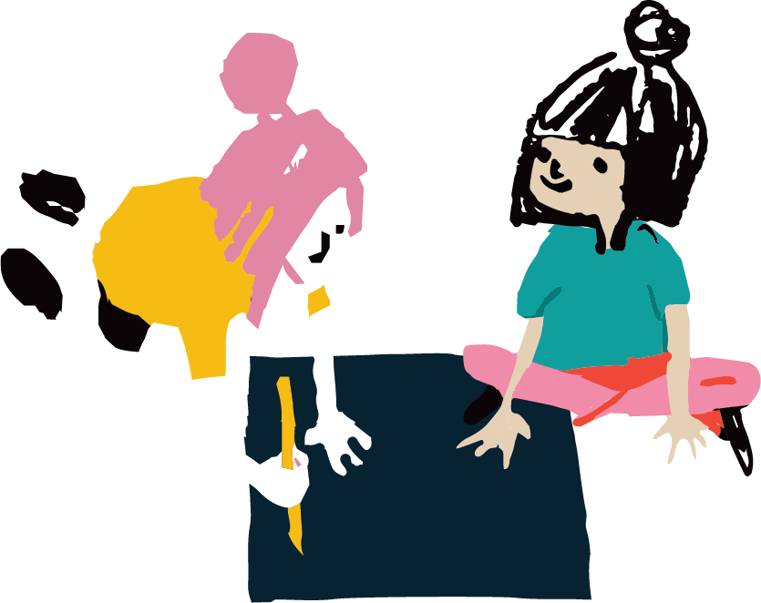
Why are we talking about this today?
We want Leeds to be an inclusive city.
We visited young people in school.
They created artwork.
Notes:
Child Friendly Leeds and Leeds Youth Voice teams in the council have teamed up with the Merrion Centre and Town Centre Securities to run a project to raise awareness of hidden disabilities and ways that we can be more inclusive of young people with SEND across the city.
Young people in schools created artwork to express how others can be more inclusive towards them. We are going to show this artwork. THEN, using the artwork we are going to try and teach people to more inclusive, in the way that young people want!

Slide 8
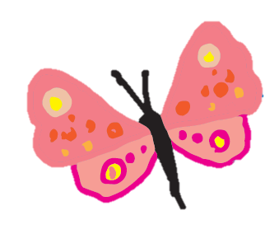
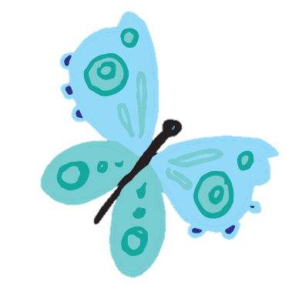
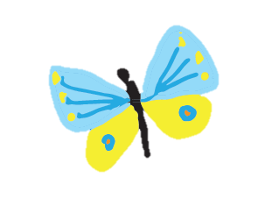
Here is some of the artwork young people created…

Slide 9
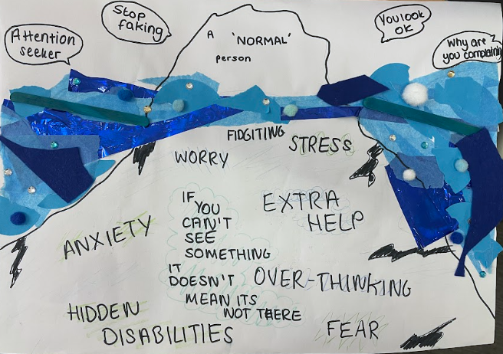
Notes:
This artwork shows things the young person has heard said to them on the surface, and a lot going on for them beneath the surface.

Slide 10
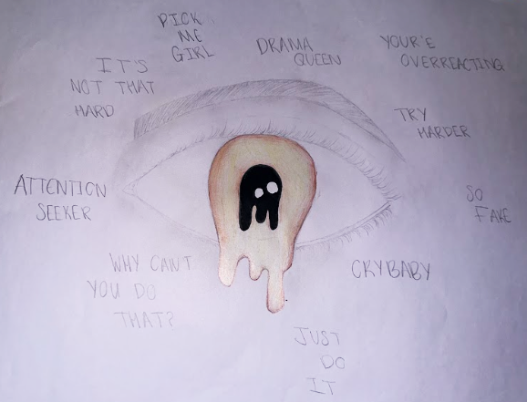
Notes:
"Attention seeker" "Why can't you do that?" "Cry baby" "try harder" "Drama queen" "so fake" – This person has faced a lot of unkind behaviour towards them.

Slide 11
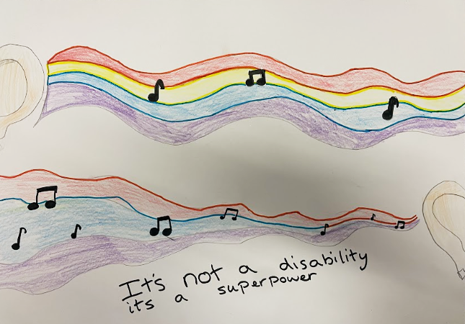
Notes:
This person feels really positively about their disability – seeing it as a superpower!

Slide 12
Some young people wrote poetry…

Slide 13
Notes:
1 min video of the poems with the young people who wrote them reading them aloud.

Slide 14
The ideas were turned into 3 posters by designers…

Slide 15
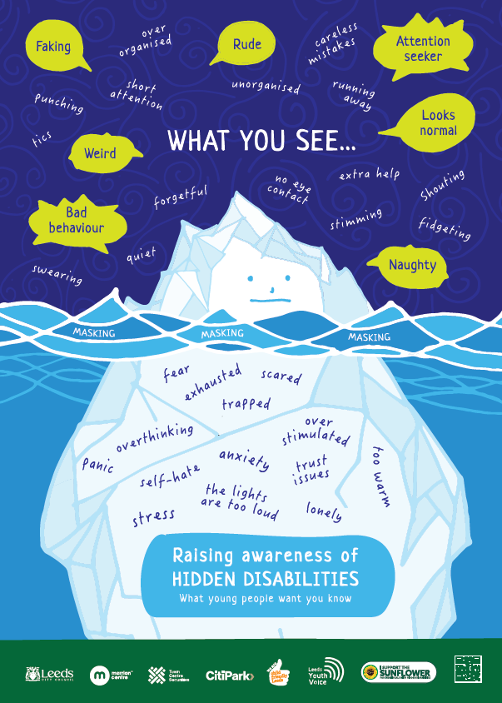
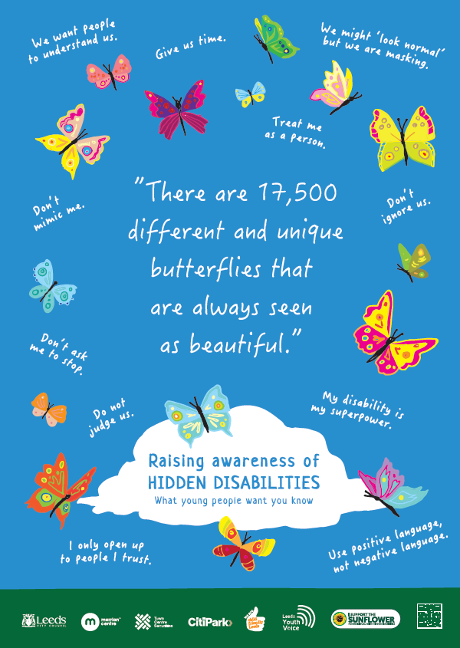
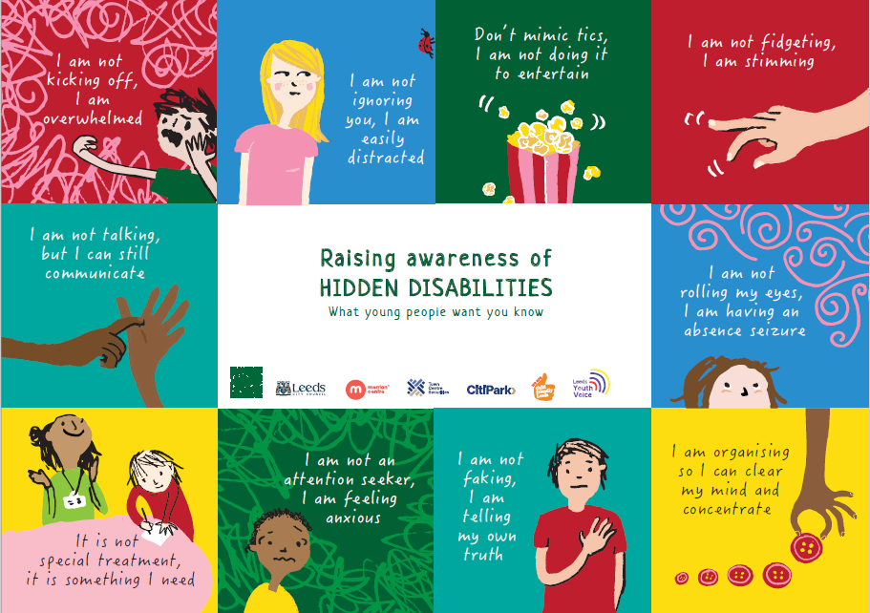

Slide 16
Let's explore some of the ideas from the posters…

Slide 17
What might you think when they look at this child?
Notes:
"Imagine you see this child in a shopping centre on the floor, or even imagine that this is a child in your classroom" Ask for ideas
Young people might say things like… - tantrum
- spoilt
Dramatic
Might stare at them wondering what's going on

Slide 18
What might you think when they look at this child?
Notes:
Imagine you are in class and you see this child's body language. Ask for ideas
Young people might say things like… - day-dreaming
- not listening
- distracted
- stupid (can't understand the problem and put their hand up)

Slide 19
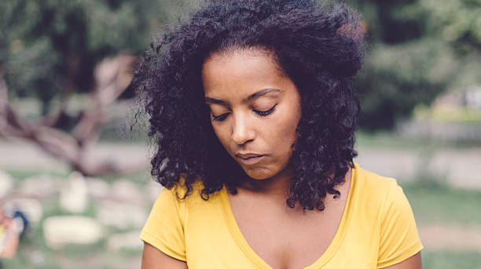
What might you think when they look at this young person?
Notes:
"Imagine you are talking to this person, or you are in a group who are all chatting away and you look around and see this person with this body language." Ask for ideas
Young people might say things like…
- shy
- not listening
- doesn't want to speak to me

Slide 20
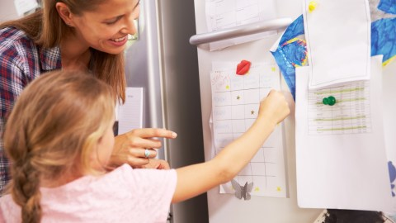
What might you think when they look at this child?
Notes:
"Imagine that there is a child in your class who has their own chart, they get stickers and they can choose rewards based on their chart". Ask for ideas.
Children might say:
- spoilt
- Not fair

Slide 21
Sometimes our first thought isn't always a fair thought…
Notes:
Today we are trying to train our brain to take a second thought. Our first thought can often be a judgemental or negative thought – so we want to try and catch this and look for a second, more positive, more kind thought!

Slide 22
Sometimes our first thought about someone isn't a fair thought
It's NOT that I'm having a tantrum, the lights feel too loud, and I'm overwhelmed.
Notes:
SOMETIMES our first thought isn't a fair thought. For some people, they might just be having a bad day BUT for some people their behaviour is as a result of their hidden disability.

Slide 23
Sometimes our first thought about someone isn't a fair thought
It's NOT that I'm ignoring you, I just take longer to process your words and sometimes I forget the thing you just said.
Notes:
SOMETIMES our first thought isn't a fair thought. For some people, they might just be tired and distracted BUT for some people their behaviour is as a result of their hidden disability.

Slide 24
Sometimes our first thought about someone isn't a fair thought
It's NOT that I don't want to talk, I just struggle with eye-contact and I still want you to talk to me!
Notes:
SOMETIMES our first thought isn't a fair thought. For some people, they might just be shy BUT for some people their behaviour is as a result of their hidden disability.

Slide 25
Sometimes our first thought about someone isn't a fair thought
It's NOT special treatment, I need this to be able to cope.
Notes:
SOMETIMES our first thought isn't a fair thought. Anyone could have a reward chart BUT for some people this is needed as a result of their hidden disability.

Slide 26
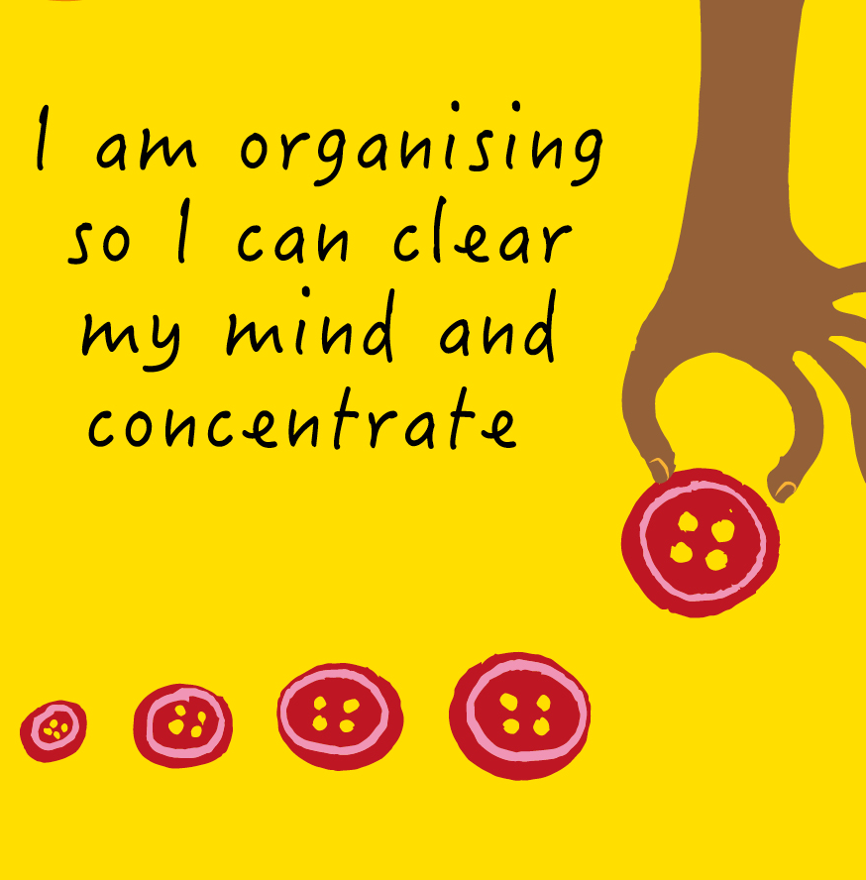
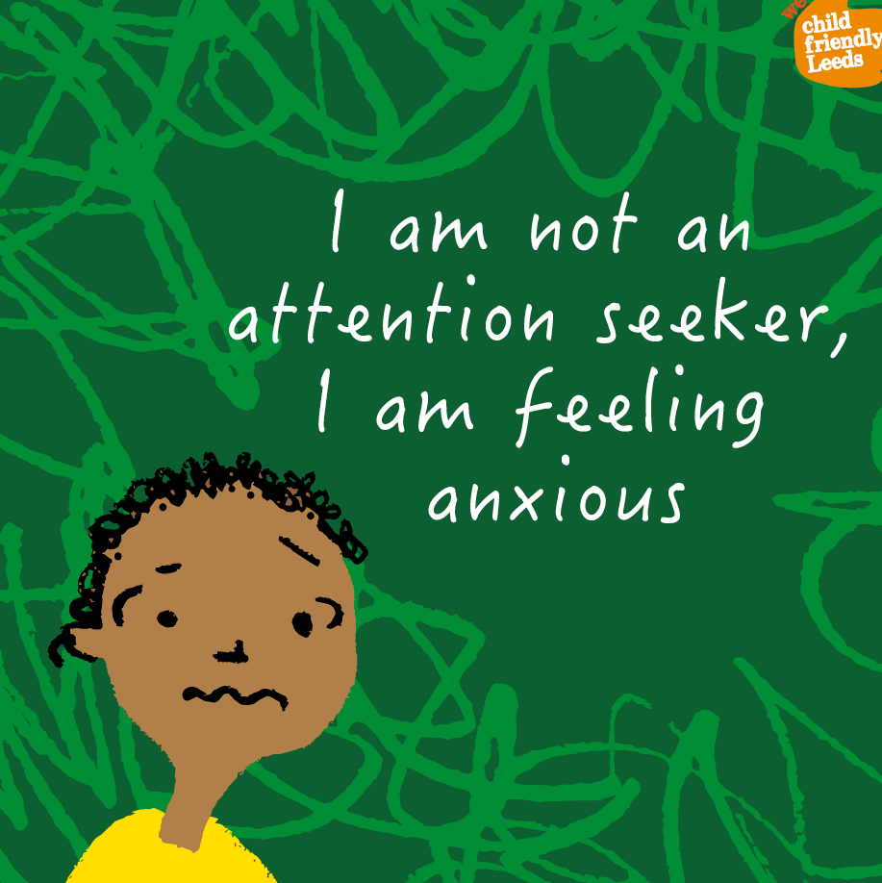
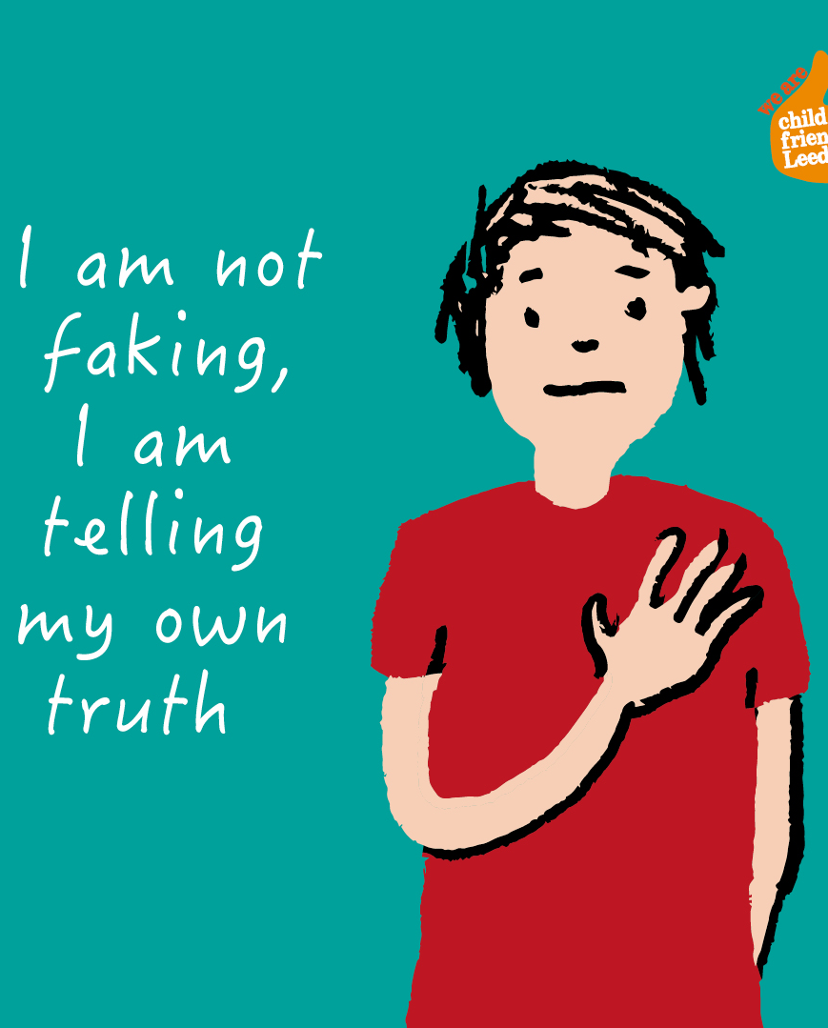
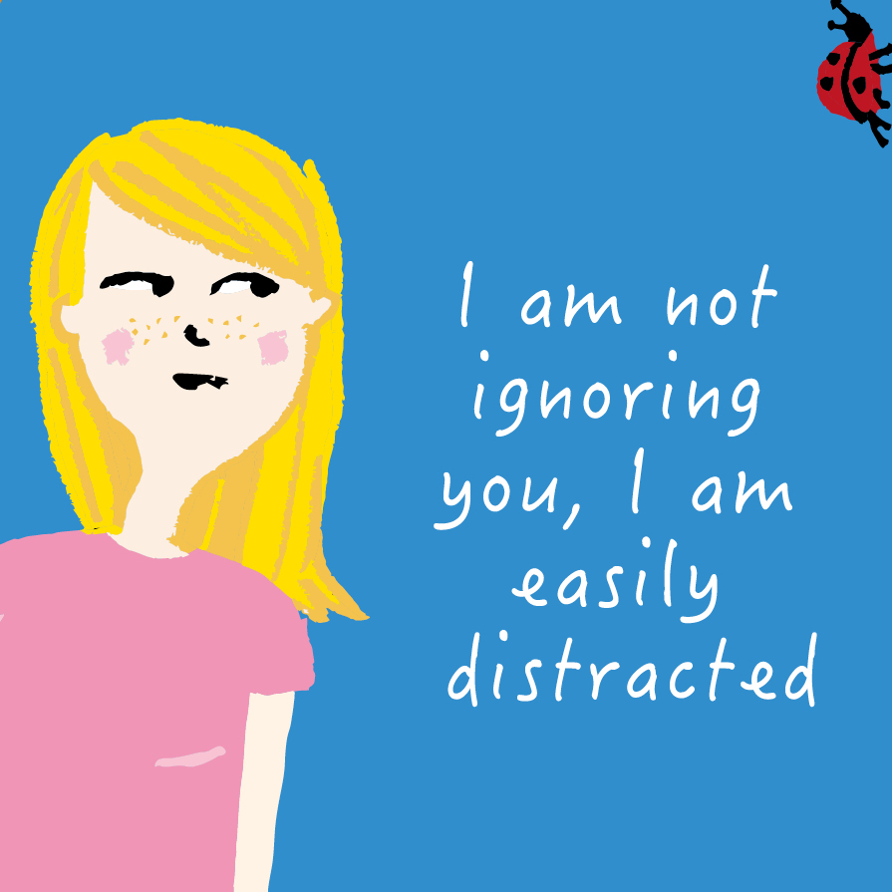
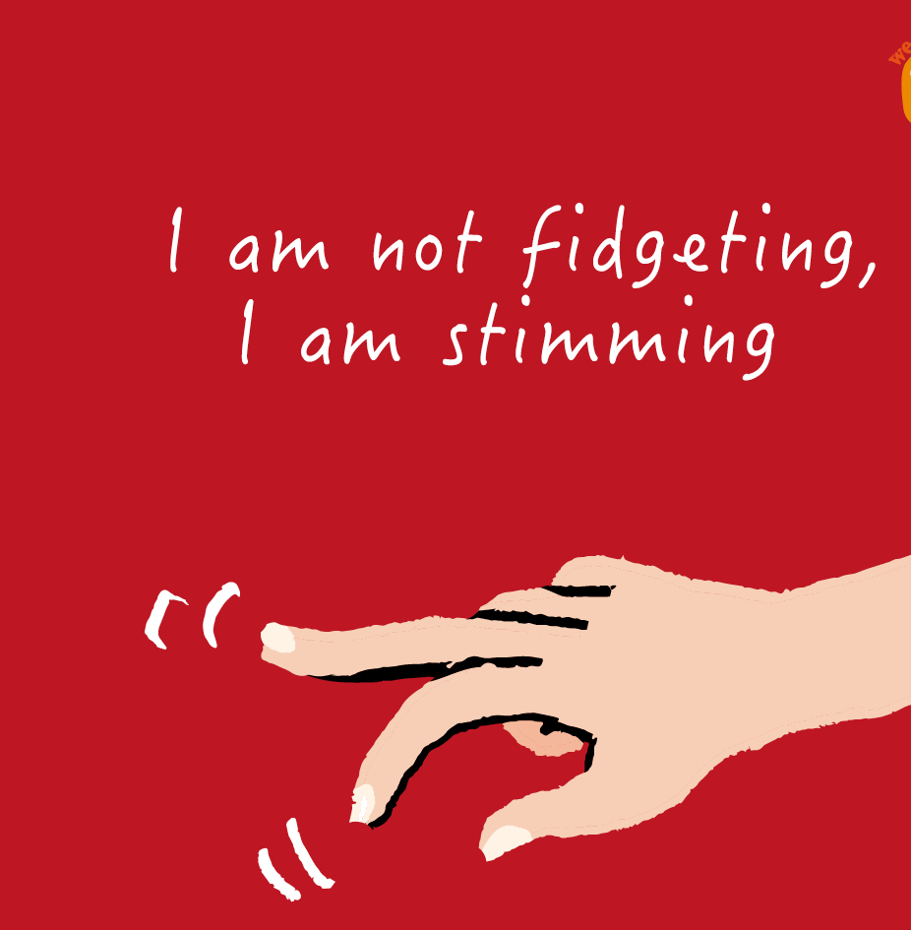
Here are some more, real cases, of when the first thought wasn't the right thought…
Notes:
These ideas are from children and young people in different schools in Leeds

Slide 27
Reflection…
Notes:
Some time for young people to reflect on what they've heard – do they relate to any of it? Do they have any questions? Will they try their best to train their brain to have that 'second thought' instead of jumping to a conclusion? Will any young people make any changes to the way they support others in their class?

Slide 28
If you want more information about this campaign, visit the
'Child Friendly Leeds Blog'
Notes:
Raising Awareness of Disability Page can be accessed via the blog website and we also have posters available to order from PHRC.
Children/young people may also want to visit the HD Sunflower website to explore the different disabilities: Hidden disabilities (hdsunflower.com)
Child Friendly Leeds 12 Wishes: https://wearechildfriendlyleeds.com/child-friendly-leeds-celebrates-10-years/
Child Friendly Leeds Blog: https://wearechildfriendlyleeds.com/

