Slide 1
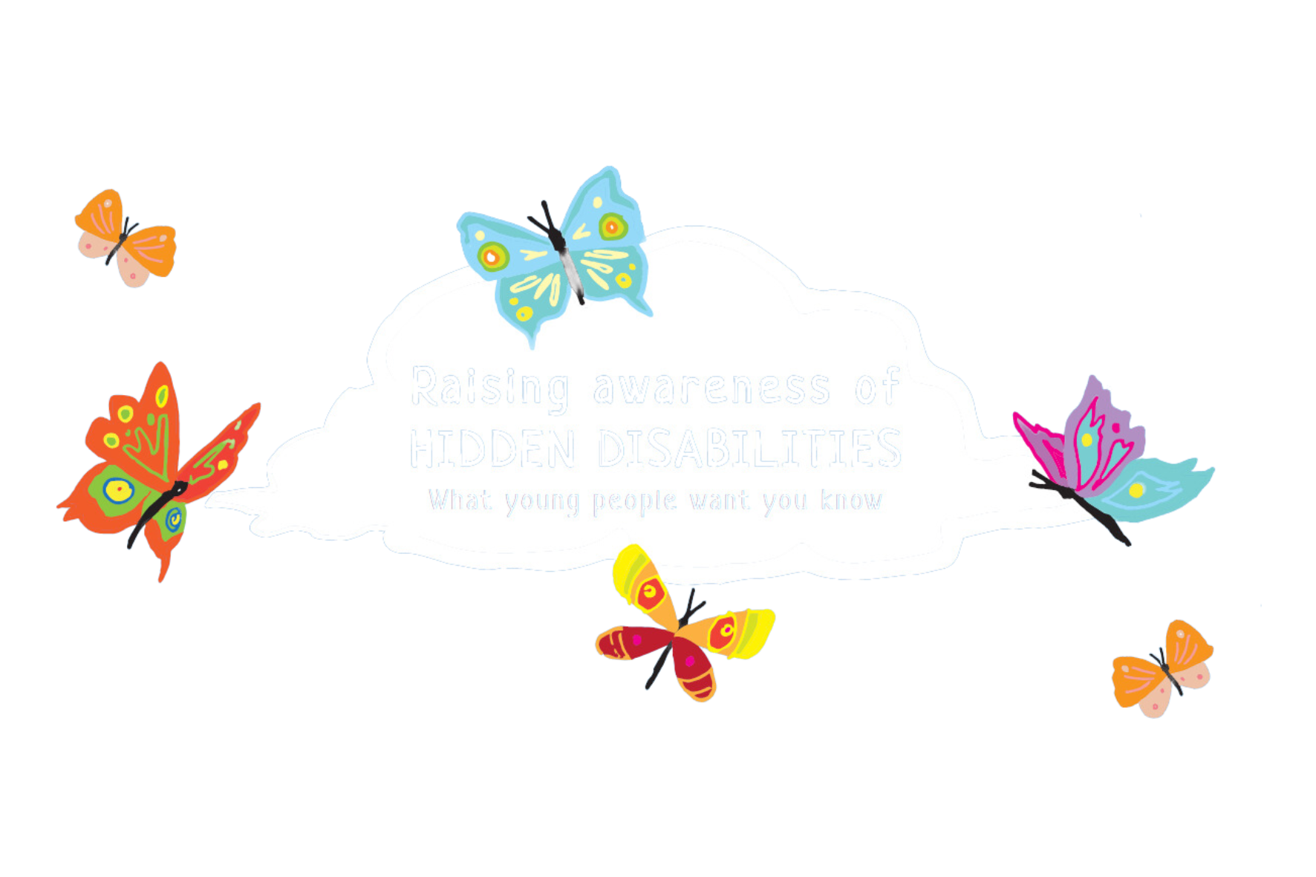
Notes:
The image is people with invisible disabilities

Slide 2
What different disabilities have you heard of?
Notes:
This is a chance to introduce the topic of 'hidden disabilities'. You may want to create some groundrules to make for a safe environment to share your thoughts before answering this question…. You might use this slide as an opportunities to tackle some of our assumptions around 'what might a disabled person look like?' to reflect on whether people's first thoughts are those with a physical disability, e.g. a wheelchair user or someone whose disability is visible, like Down's Syndrome or someone with a visual impairment who is using a guide dog or stick.

Slide 3
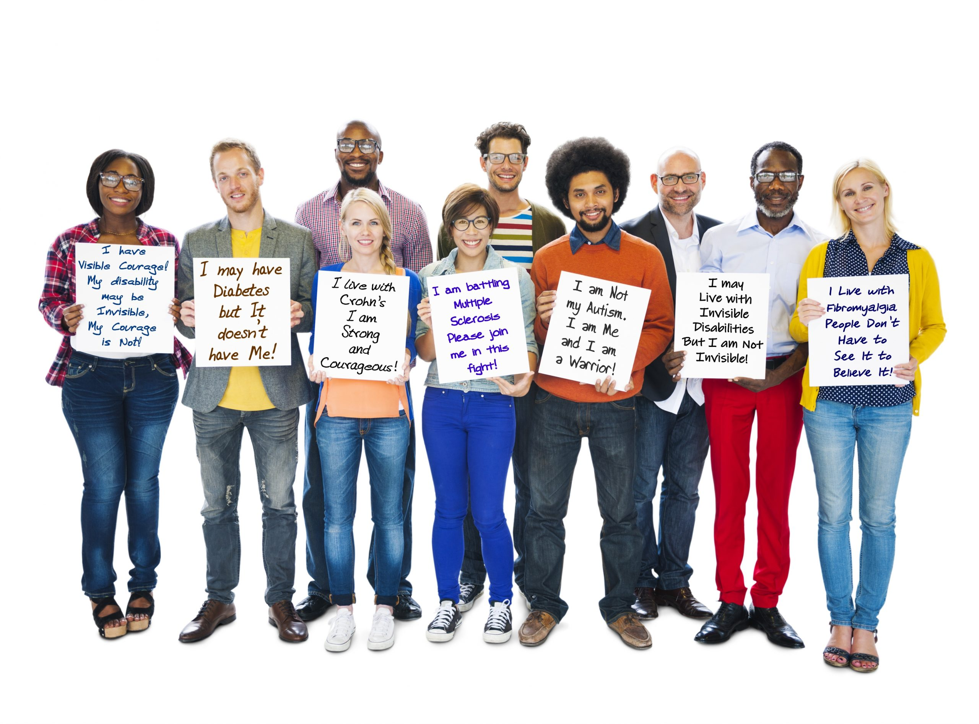
These people all have 'hidden' disabilities…
Notes:
These people all have hidden disabilities like diabetes and Chron's. These people might have symptoms that can impact their life, but they don't look physically disabled.
For example, someone with diabetes might have to be very careful about their diet, so they might not be able to share food in class and would have to take extra care on a school trip, to make sure they have the right medical equipment. Though they may not 'look' disabled, they are facing extra barriers in life.

Slide 4
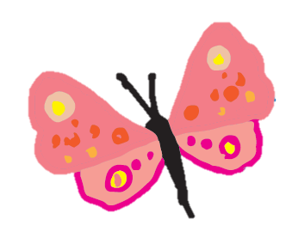
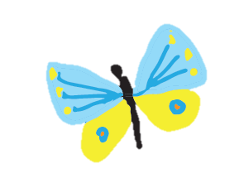
Why are we talking about this today?

Slide 5
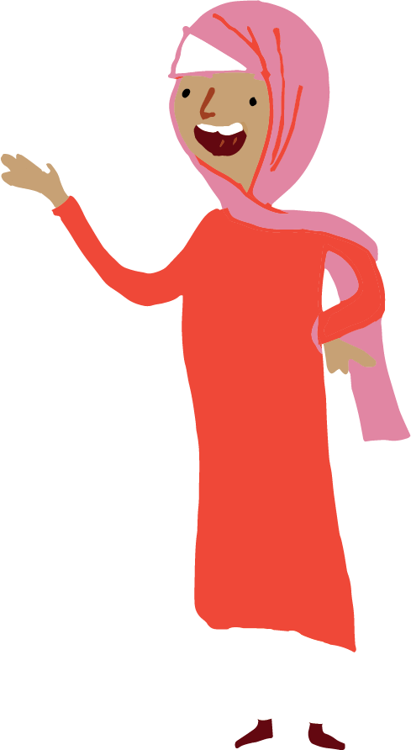
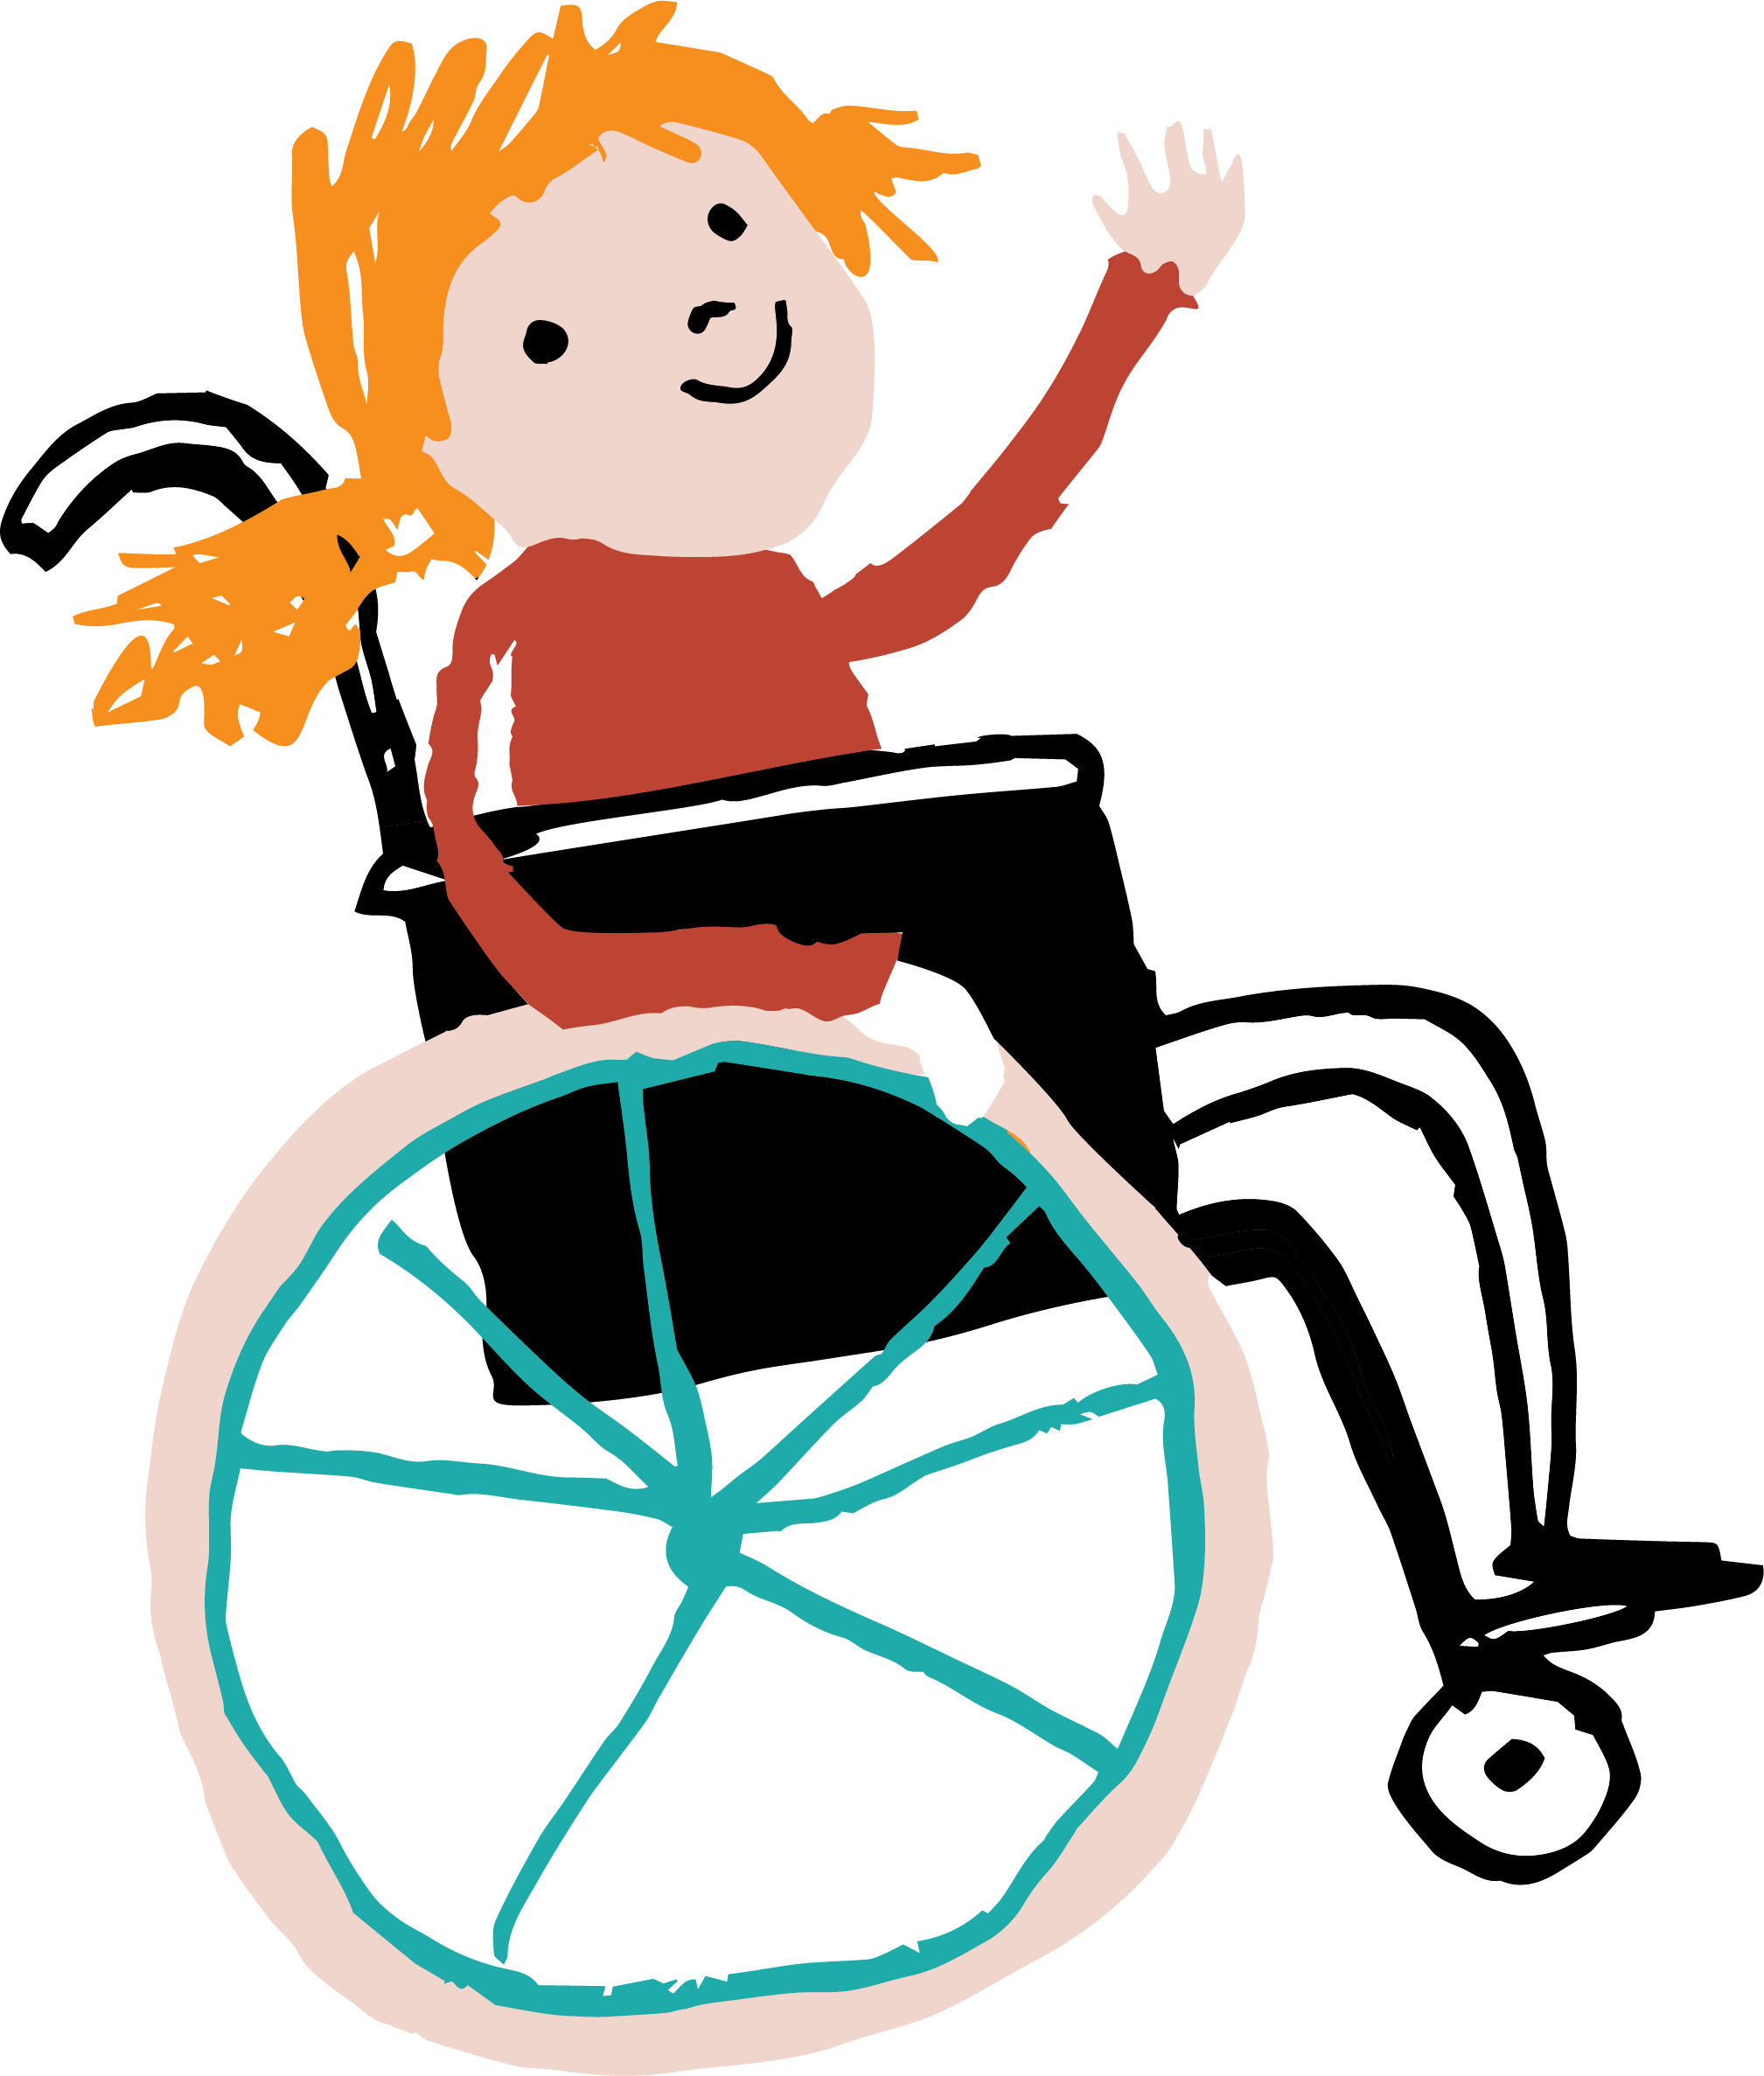
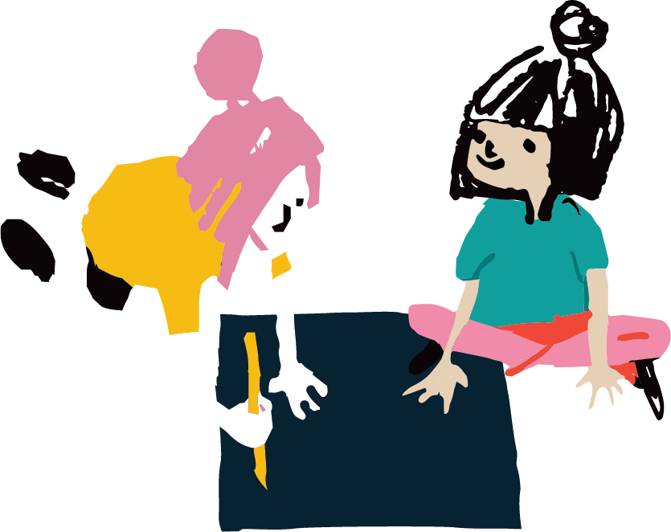
Why are we talking about this today?
We want Leeds to be an inclusive city.
We visited young people in school.
They created artwork.
Notes:
This slide introduces the context of this project by Child Friendly Leeds and Leeds Youth Voice teams in the council, and the Merrion Centre and Town Centre Securities. The next few slides explain each part…
Young people in schools created artwork to express how others can be more inclusive towards them. We are going to show this artwork. THEN, using the artwork we are going to try and teach people to more inclusive, in the way that young people want!

Slide 6
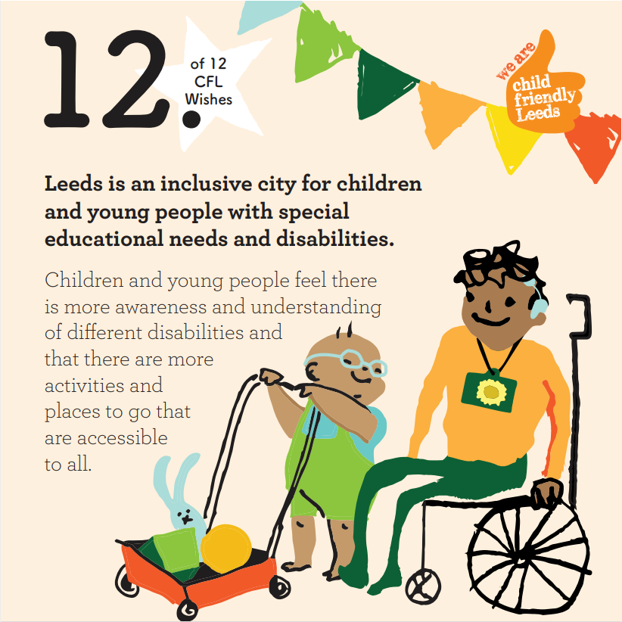
We want Leeds to be an inclusive city.
Notes:
The first part of the project is the aim for Leeds to be a more inclusive city. This ties in with Wish 12 of the Child Friendly Leeds 12 wishes. The 12 wishes, that the Child Friendly Leeds team work on, have come from the voices and ideas of 80,000 children and young people. To find out more visit: Child Friendly Leeds 12 Wishes (wearechildfriendlyleeds.com)

Slide 7
We visited young people in school.
In Autumn 2023, five groups participated in the project, expressing what they would like to share with others about their disabilities, what makes them unique, and how we can make a difference..
John Jamieson East SILC
St John’s School
Horsforth School
Brigshaw Academy (16+)
SEND Youth Council

Slide 8
They created artwork.
The young people used art materials, sponsored by Merrion Centre, to answer the question…
“How can Leeds be more inclusive to those with hidden disabilities?”
…so that children and young people are not feeling judged.

Slide 9
The artwork…

Slide 10
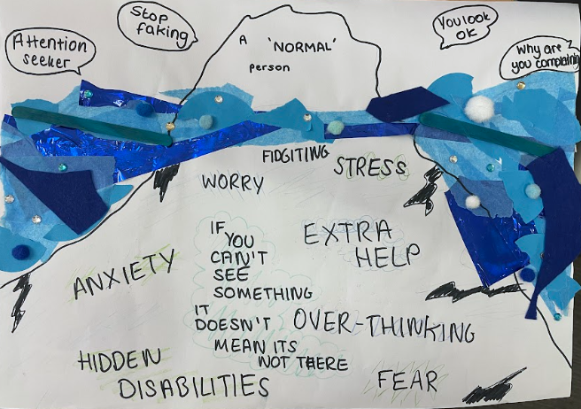

Slide 11
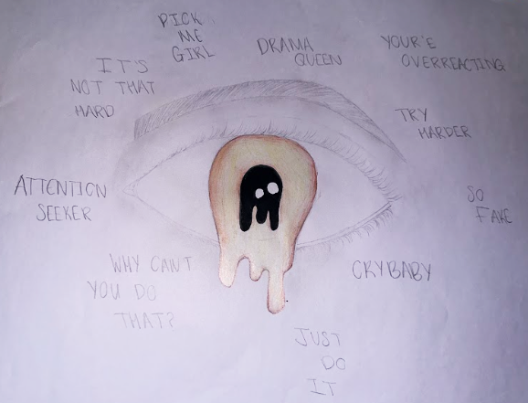
Notes:
"Attention seeker" "Why can't you do that?" "Cry baby" "try harder" "Drama queen" "so fake"

Slide 12
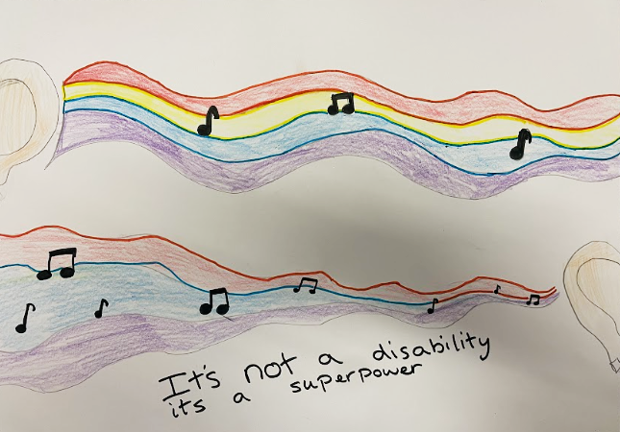

Slide 13
Some young people wrote poetry…

Slide 14
Notes:
2 min video of the poems with the young people who wrote them reading them aloud.

Slide 15
The ideas were turned into 3 posters by designers…

Slide 16
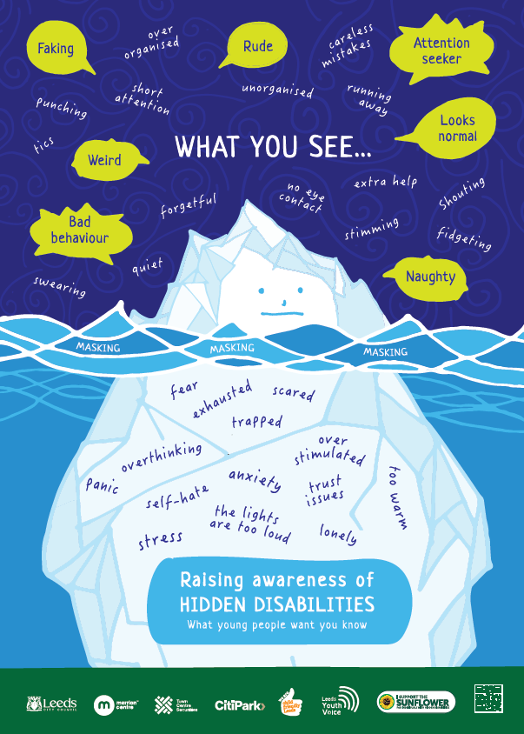
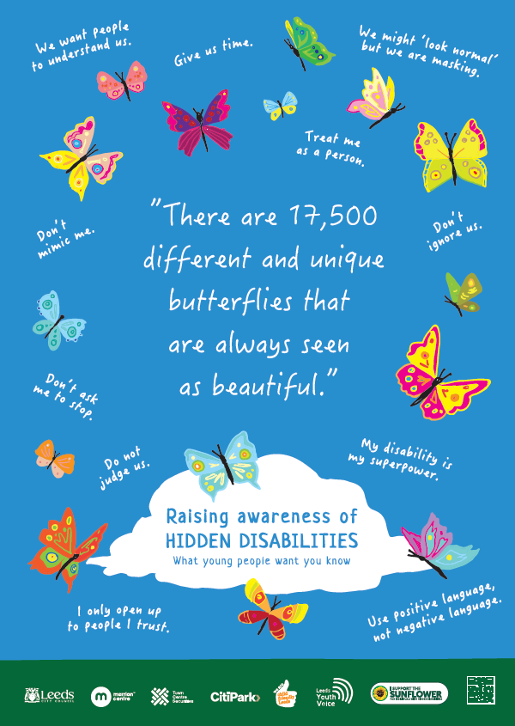
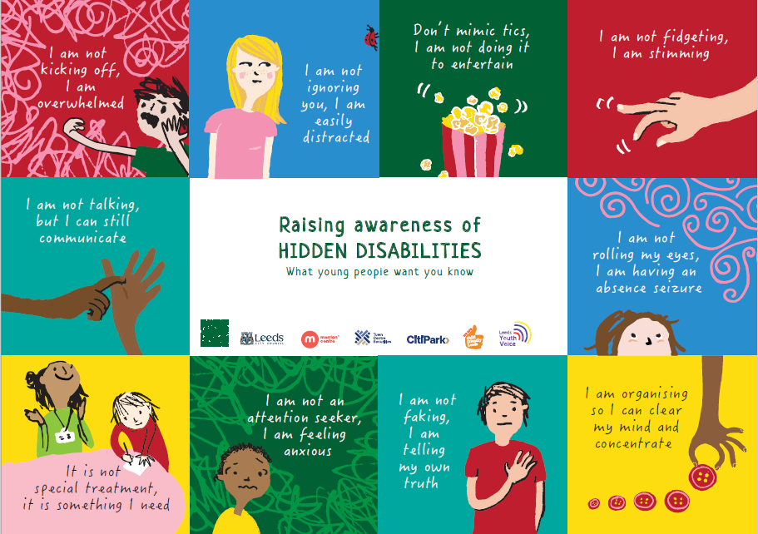

Slide 17
Let's explore some of the ideas from the posters…

Slide 18
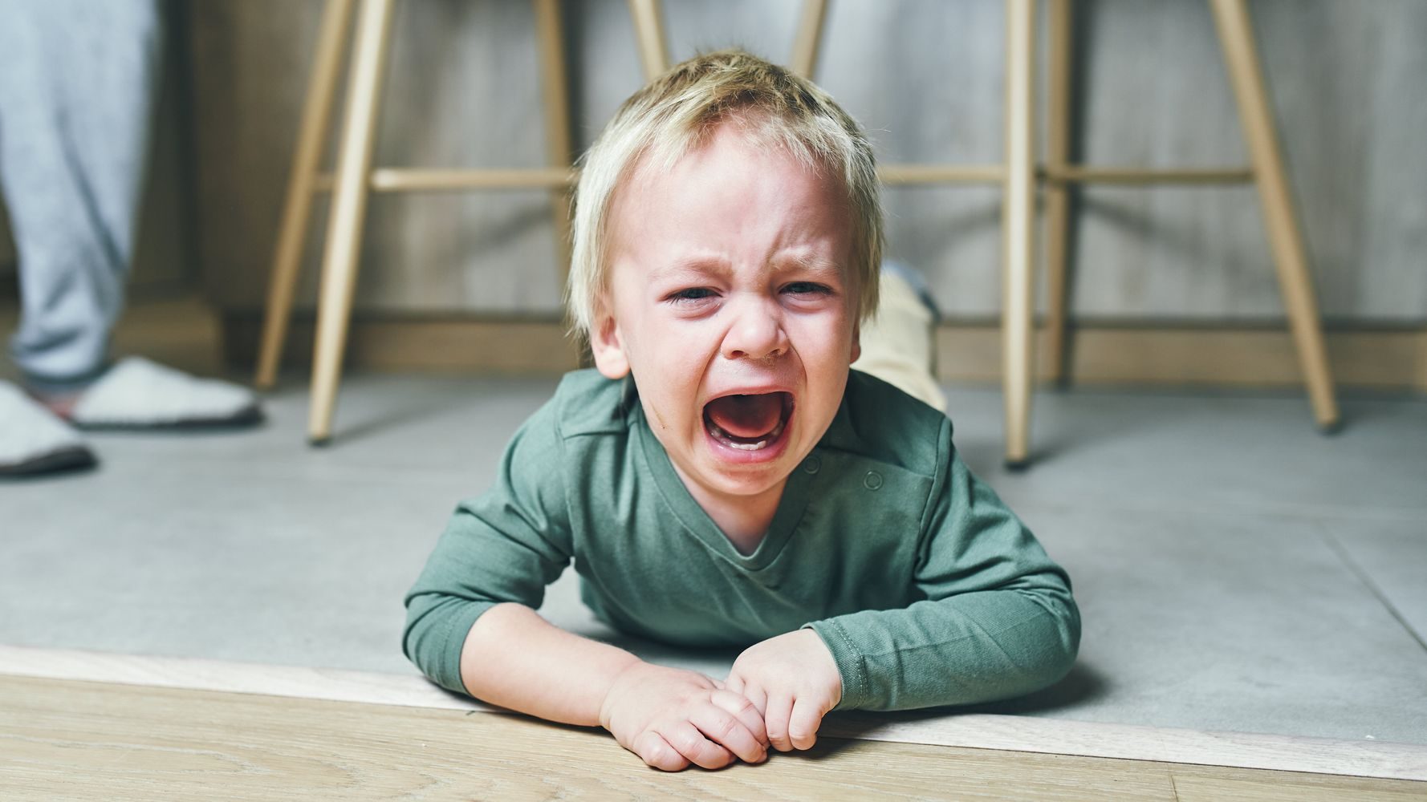
What might you think when they look at this child?
Notes:
"Imagine you see this child in a shopping centre on the floor, or even imagine that this is a child in your classroom" Ask for ideas
People might say things like… - tantrum
- spoilt
- dramatic

Slide 19
What might you think when they look at this child?
Notes:
Ask for ideas
People might say things like… - day-dreaming
- not listening
- distracted
- stupid (can't understand the problem and put their hand up)

Slide 20
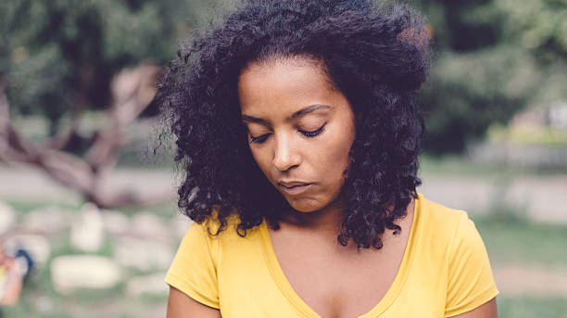
What might you think when they look at this young person?
Notes:
"Imagine you are talking to this person, or you are in a group who are all chatting away and you look around and see this person with this body language." Ask for ideas
People might say things like…
- shy
- not listening
- doesn't want to speak to me

Slide 21
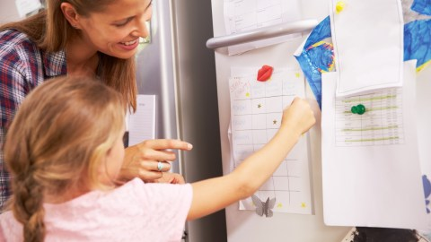
What might you think when they look at this young person?
Notes:
"Imagine that there is a child in your class who has their own chart, they get stickers and they can choose rewards based on their chart". Ask for ideas.
People might say:
- spoilt
- special treatment
- not fair

Slide 22
Sometimes our first thought isn't always a fair thought…

Slide 23
Sometimes our first thought about someone isn't a fair thought
It's NOT that I'm having a tantrum, the lights feel too loud, and I'm overwhelmed.
Notes:
The ideas for the words used on the right hand of the slide came from young people who took part in the project.

Slide 24
Sometimes our first thought about someone isn't a fair thought
It's NOT that I'm ignoring you, I just take longer to process your words and sometimes I forget the thing you just said.
Notes:
The ideas for the words used on the right hand of the slide came from young people who took part in the project.

Slide 25
Sometimes our first thought about someone isn't a fair thought
It's NOT that I don't want to talk, I just struggle with eye-contact and I still want you to talk to me!
Notes:
The ideas for the words used on the right hand of the slide came from young people who took part in the project.

Slide 26
Sometimes our first thought about someone isn't a fair thought
It's NOT special treatment, I need this to be able to cope.
Notes:
The ideas for the words used on the right hand of the slide came from young people who took part in the project.

Slide 27
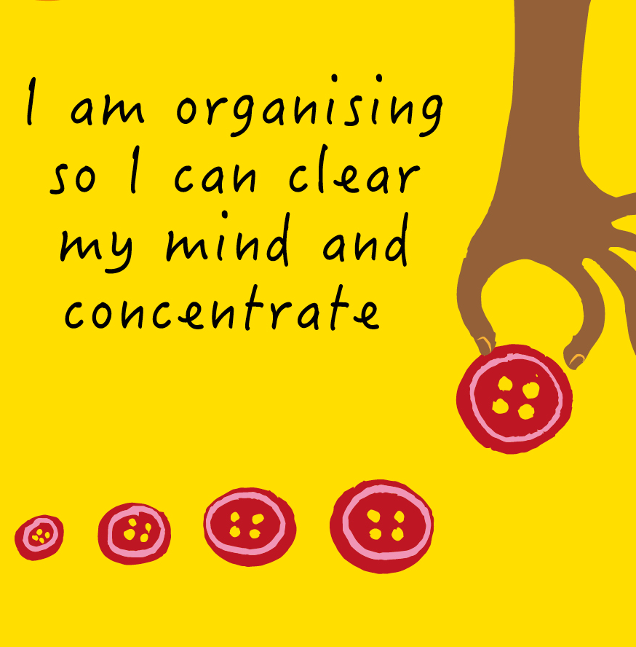
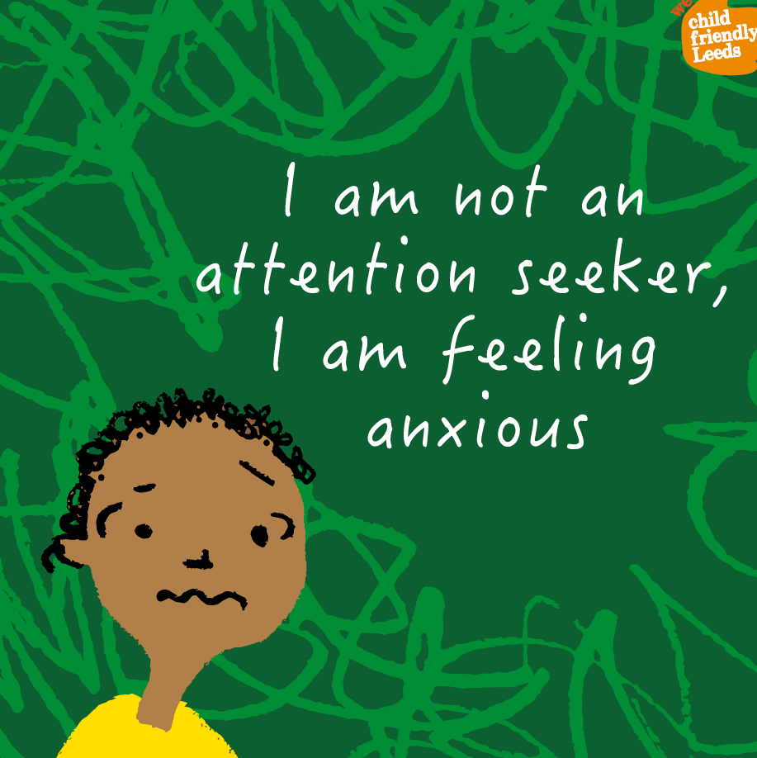
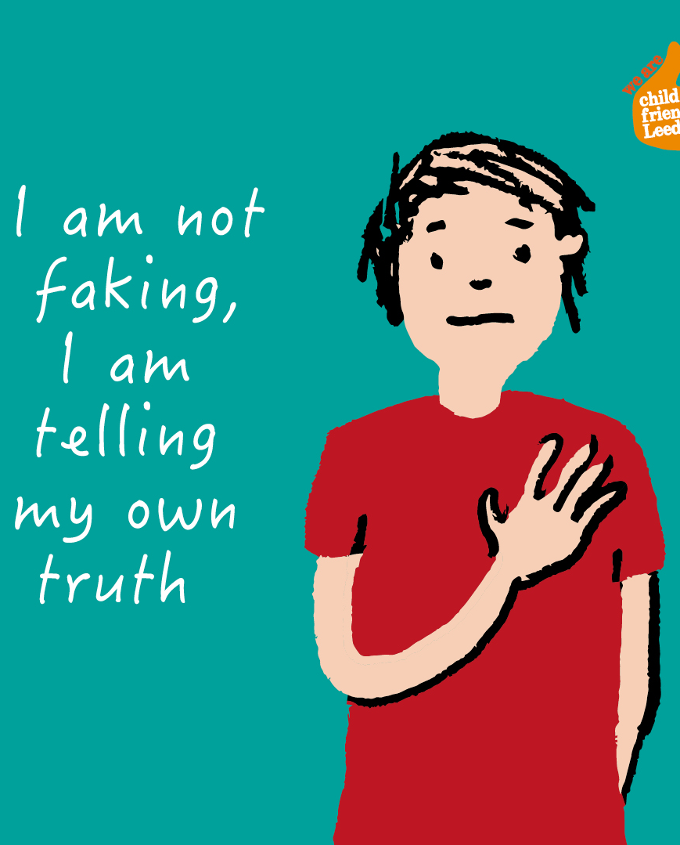
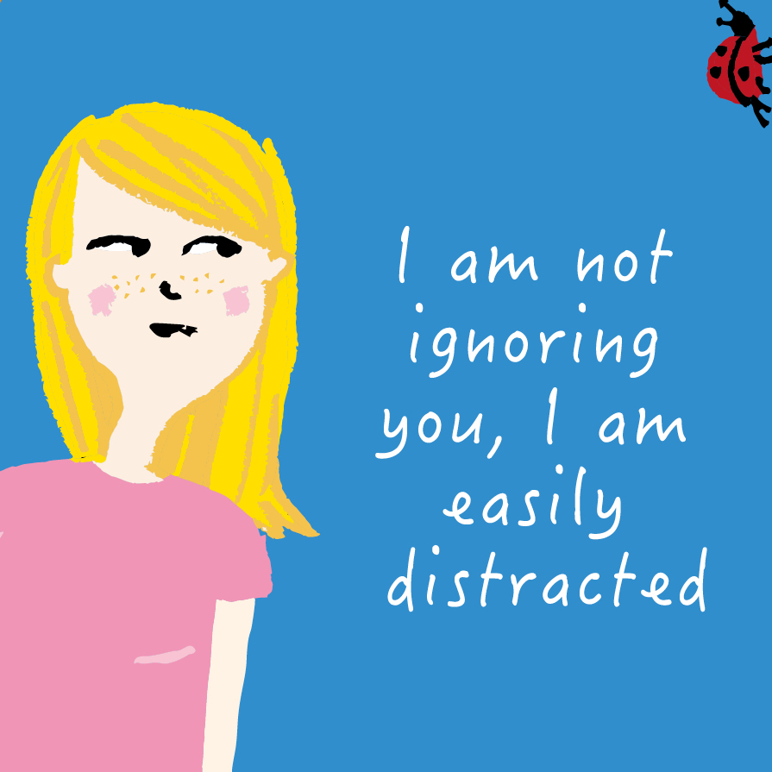
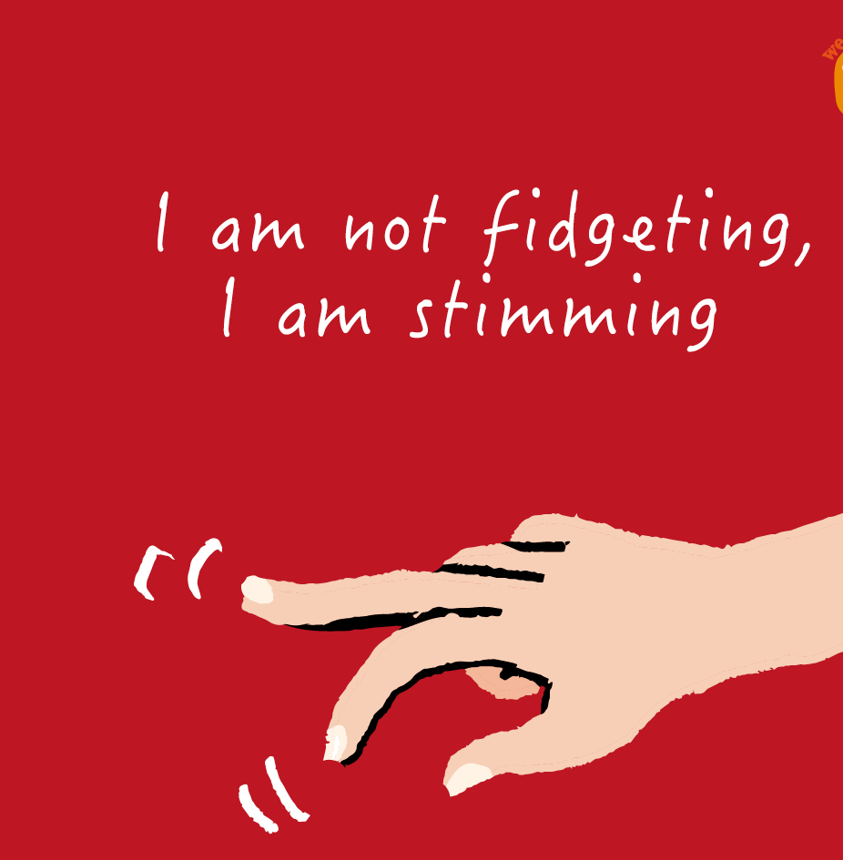
Here are some more, real cases, of when the first thought wasn't the right thought…
Notes:
These ideas are from children and young people in different schools in Leeds

Slide 28
Reflection…
Notes:
Some time to reflect on the topics covered. Is there any way we can apply this to the work we do? Are we well-equipped to support people with hidden disabilities? Are front-line staff equipped?

Slide 29
If you want more information about this campaign, visit the
'Child Friendly Leeds Blog'
Notes:
Raising Awareness of Disability Page can be accessed via the blog website and we also have posters available to order from PHRC.
Child Friendly Leeds 12 Wishes: https://wearechildfriendlyleeds.com/child-friendly-leeds-celebrates-10-years/
Child Friendly Leeds Blog: https://wearechildfriendlyleeds.com/

Slide 30
It's important that this is a city-wide message…
You can order A3 size (A4 coming soon) posters, for free, from the Public Health Resource Centre:
Sign-up, then…
P758 Butterflies poster
P756 Iceberg poster
P757 Educational poster
Notes:
This is the call to action
Complete and return the order form to phrc.forms@leeds.gov.uk, you will need to register here if you haven’t already ordered resources from the Public Health Resource Centre.

