Slide 1
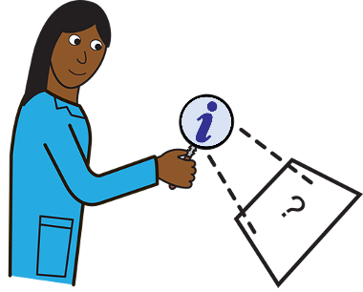
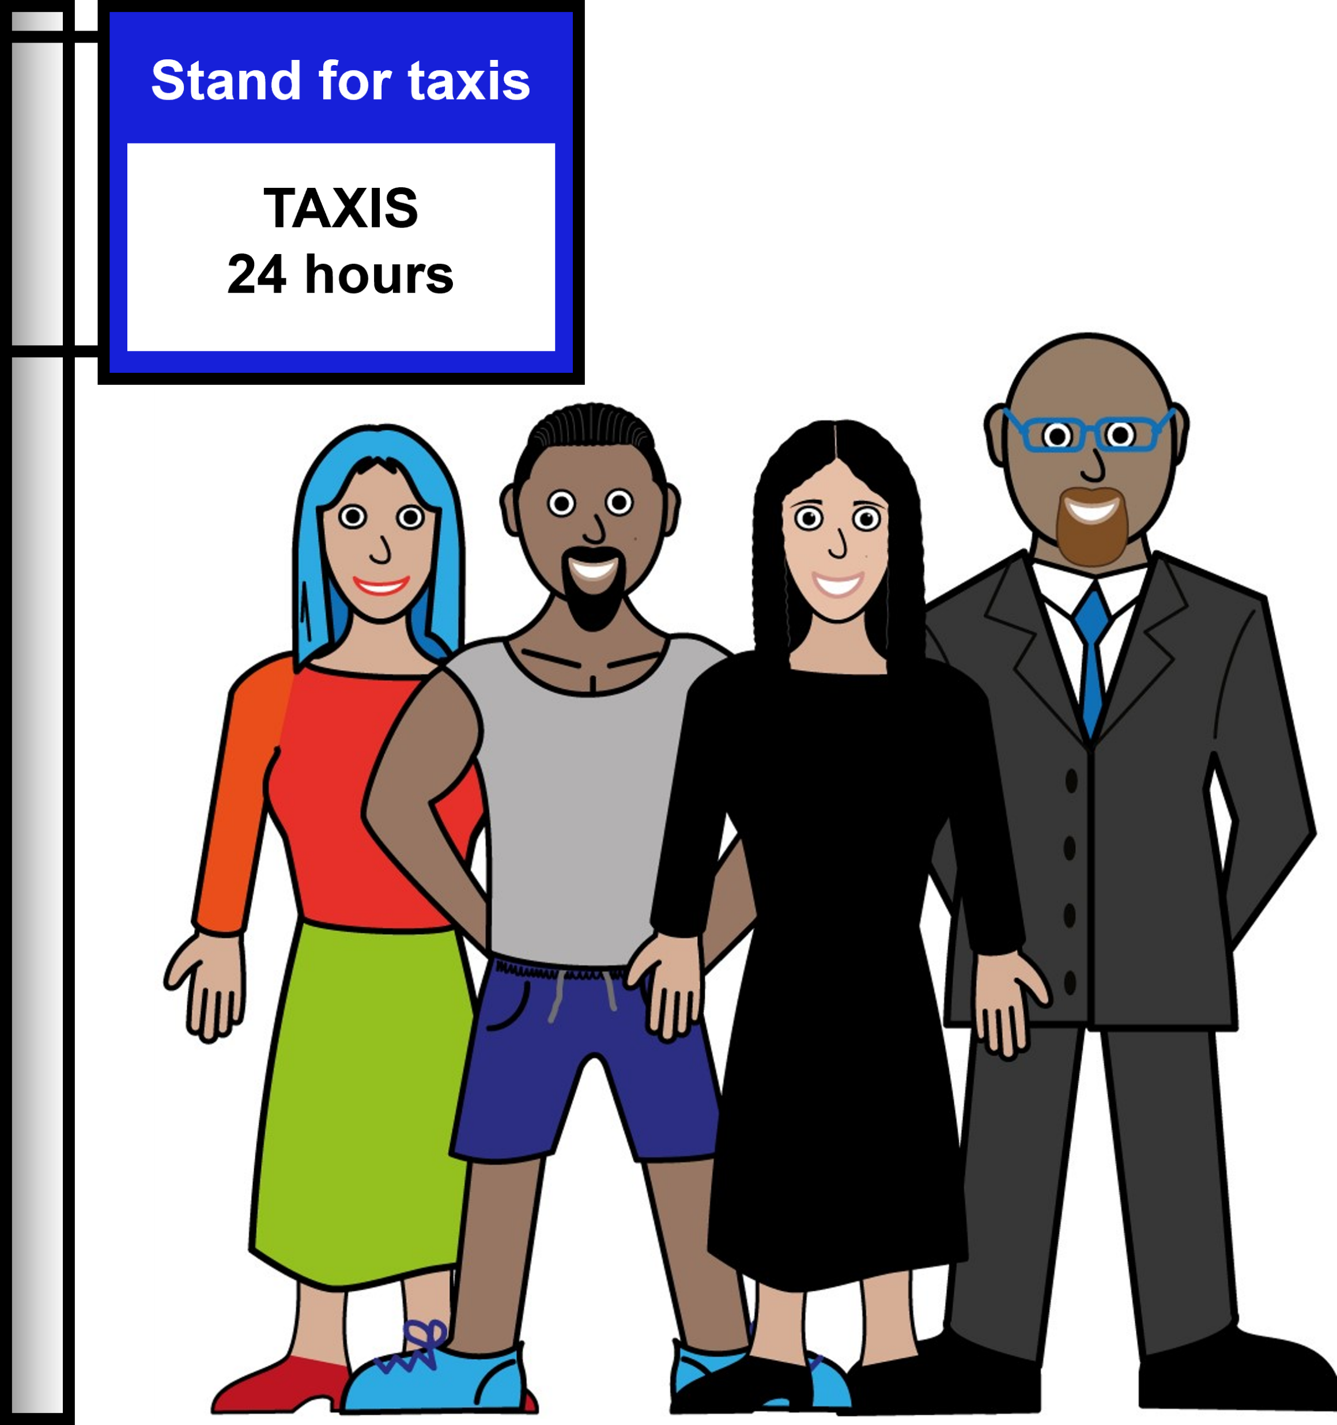
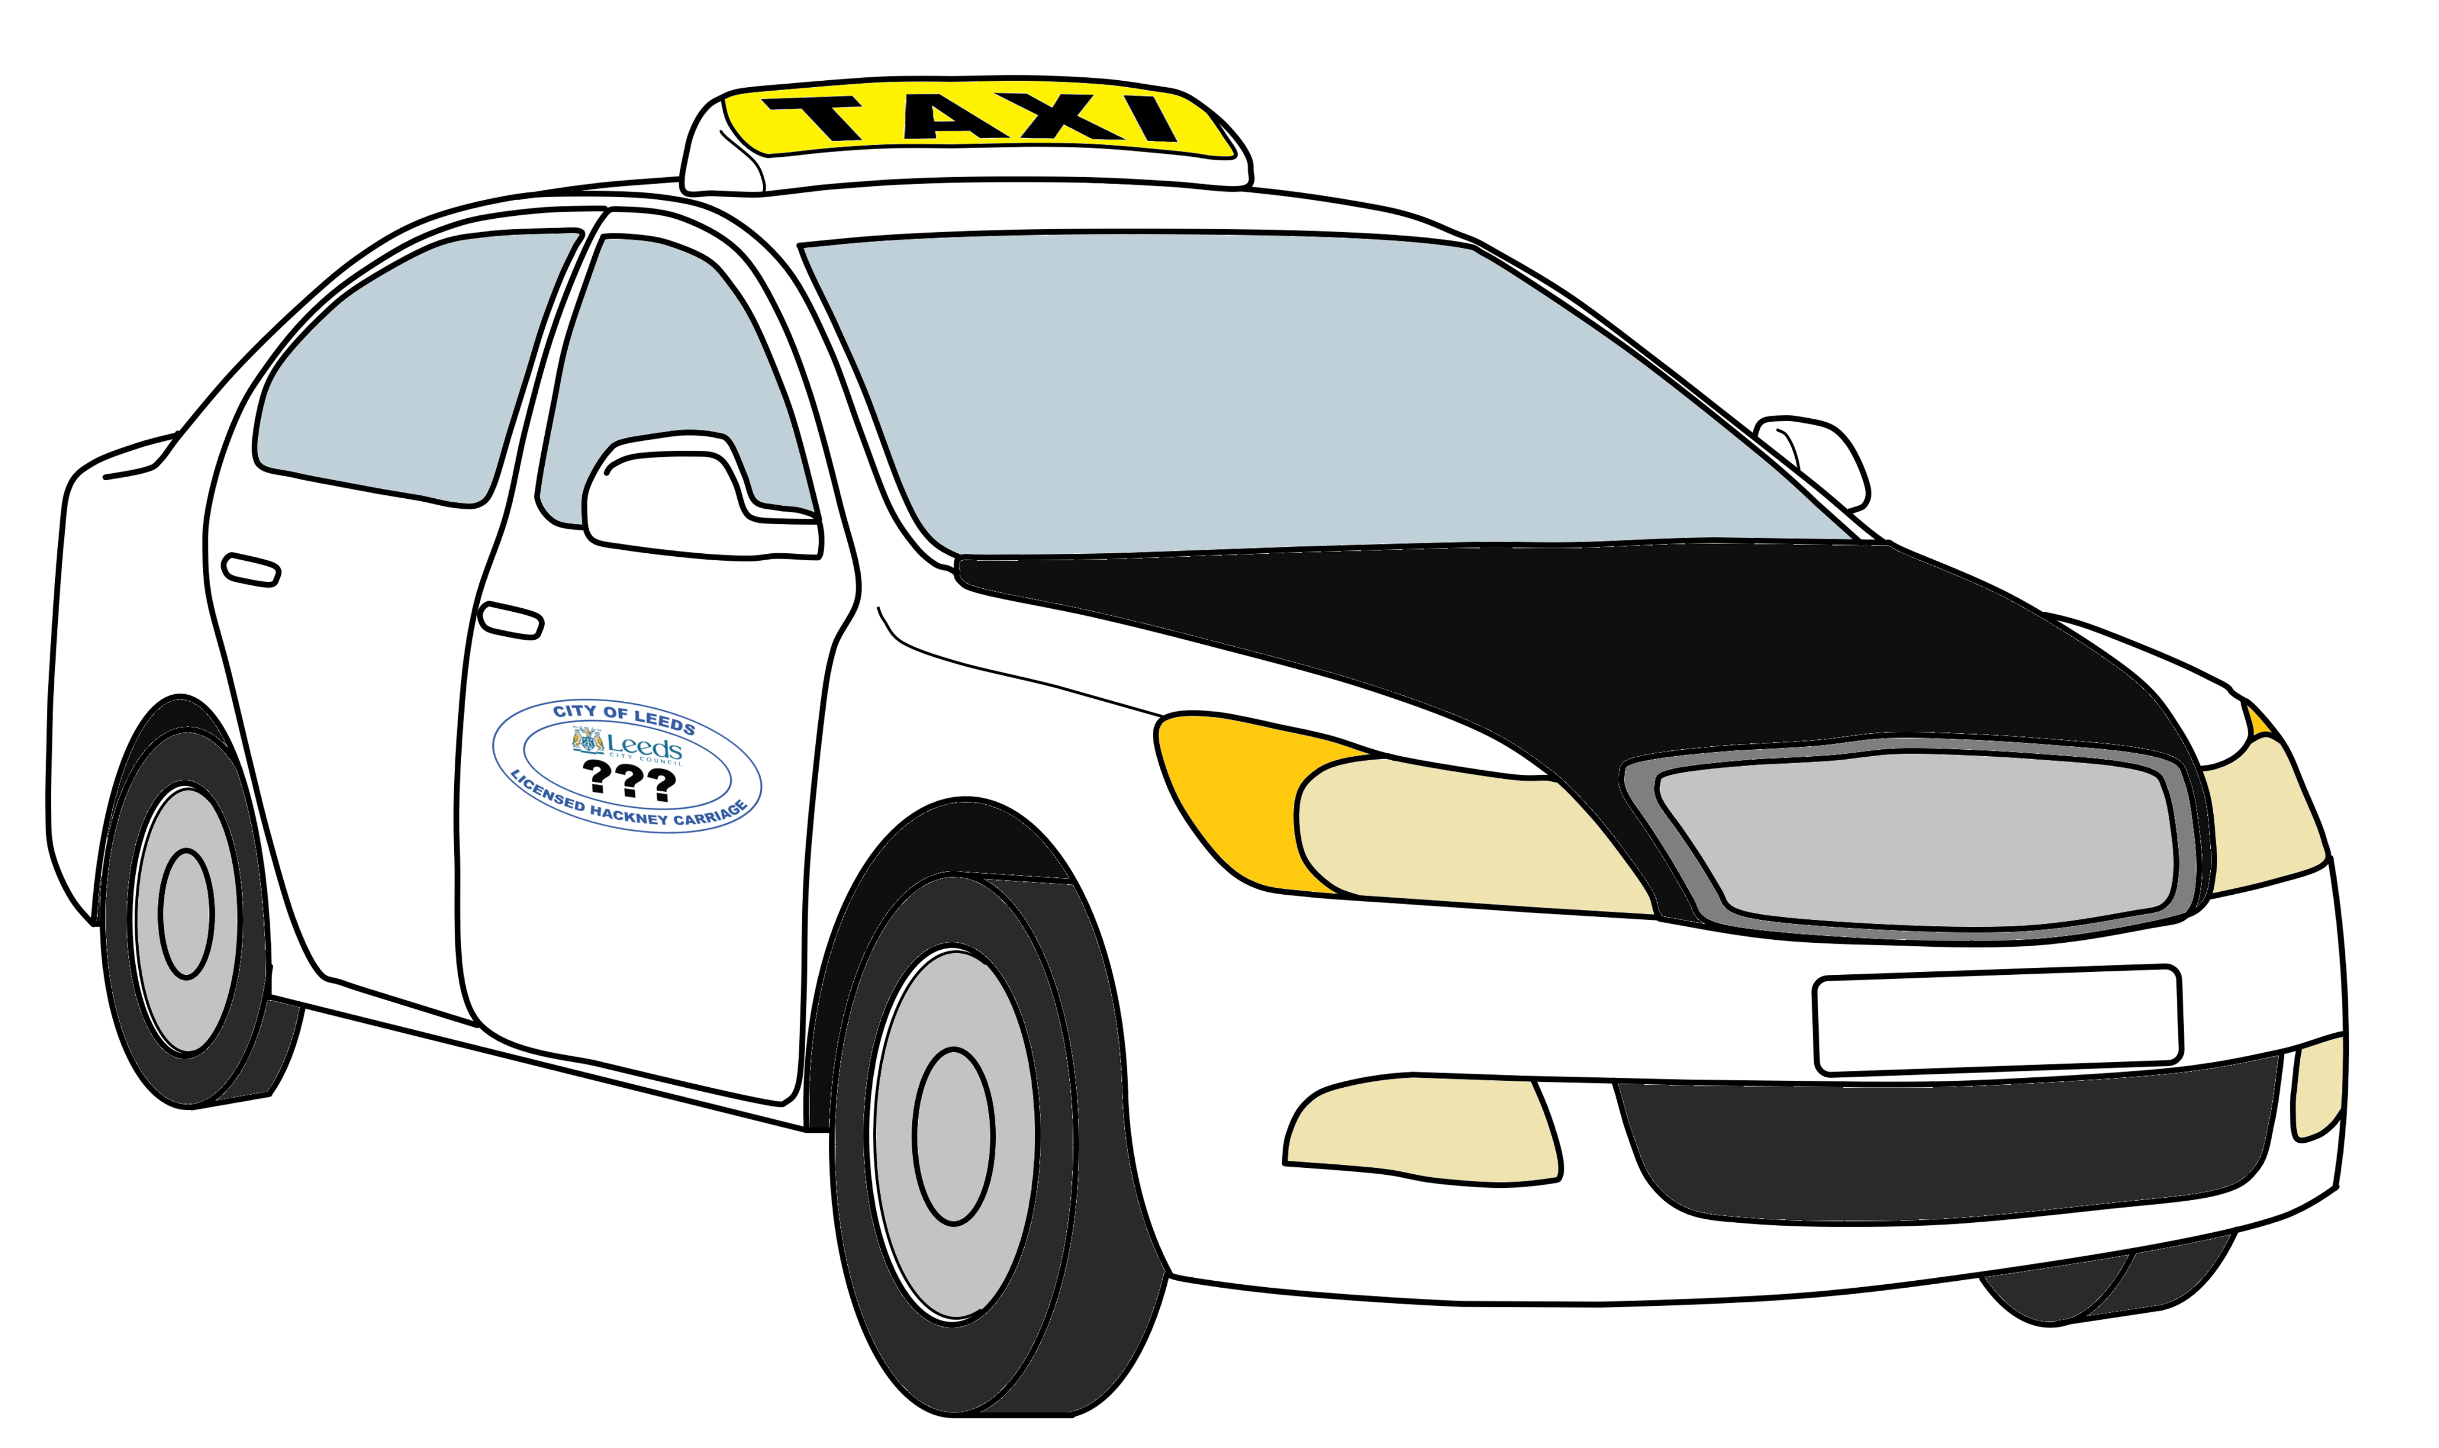
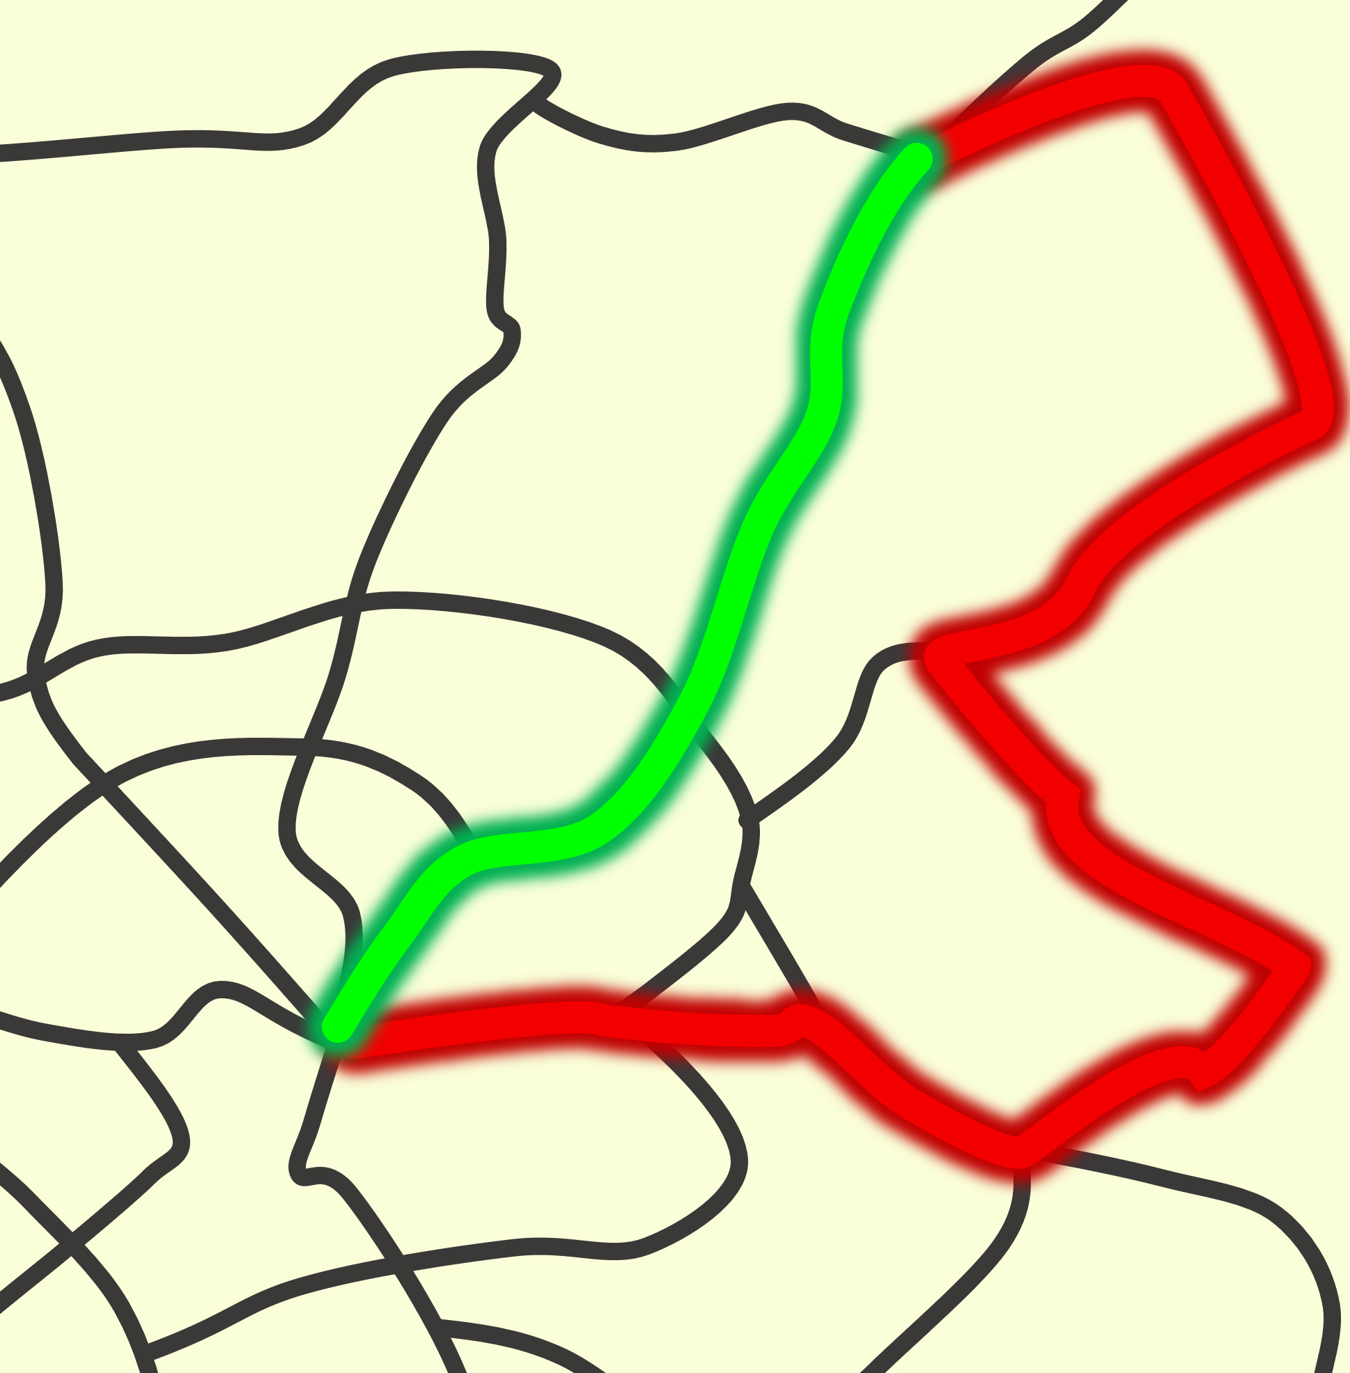
There are two kinds of taxis in Leeds.
Let’s look at… taxis in Leeds
Some taxis are black and white.
These are called Hackney cabs.
Taxi!
Black and white taxis are allowed to pick up people at taxi ranks.
And they are allowed to pick up people who see them in the street.
They have a meter which says how much to pay. This counts up as the taxi ride goes on.
The amount it goes up is set by the City Council.
The rules say these taxis must go the shortest way.
If you want the taxi driver to go a certain way you must tell them at the start of the ride.

Slide 2
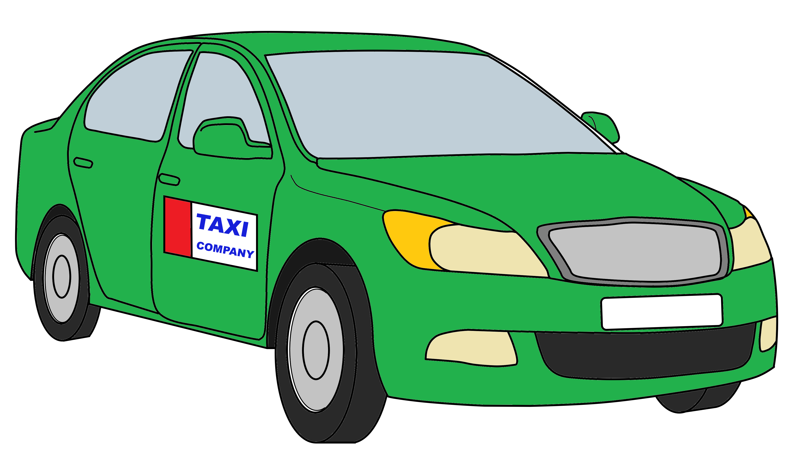
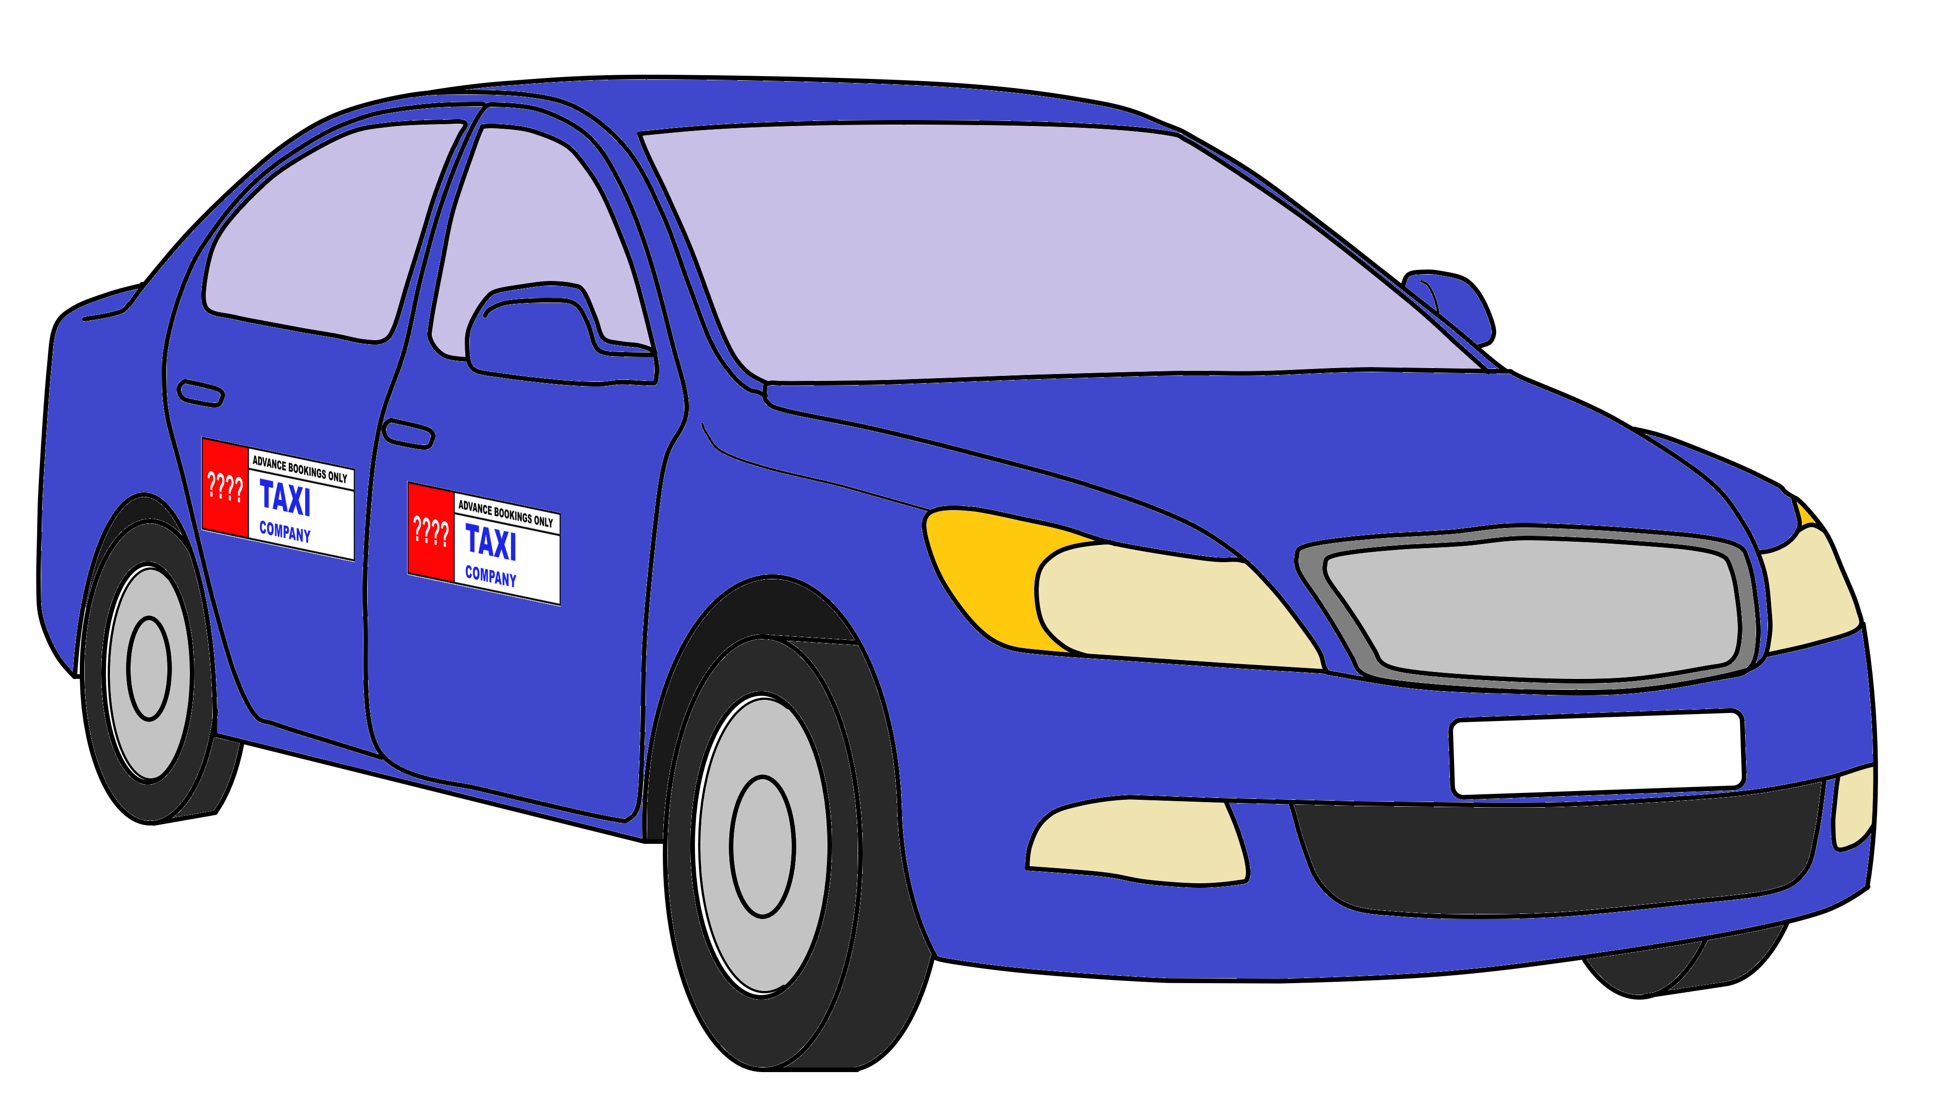
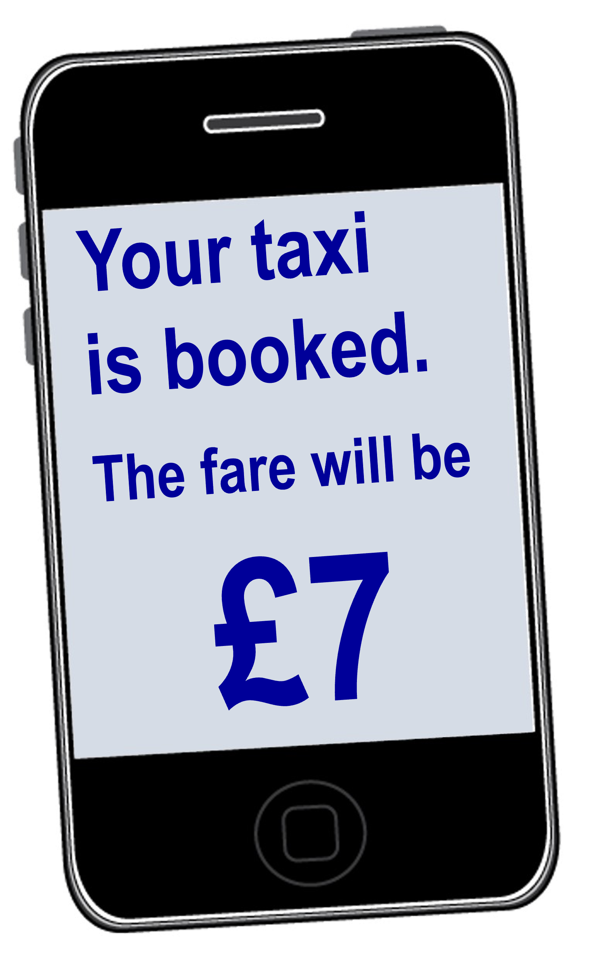
Some taxis are ordinary cars.
These are called private hire vehicles.
They have a sign like this to show they are a taxi.
Taxis in Leeds are allowed to work for two companies at the same time.
These taxis are only allowed to pick people up who have booked them.
You can book these taxis by phone.
And a lot of taxi companies have apps for booking.
The cost of the taxi ride is estimated when you book.
(Estimated means the amount might change a bit. But it gives you a good idea what the cost will be.)
Please can I have a taxi
It will be £7

Slide 3
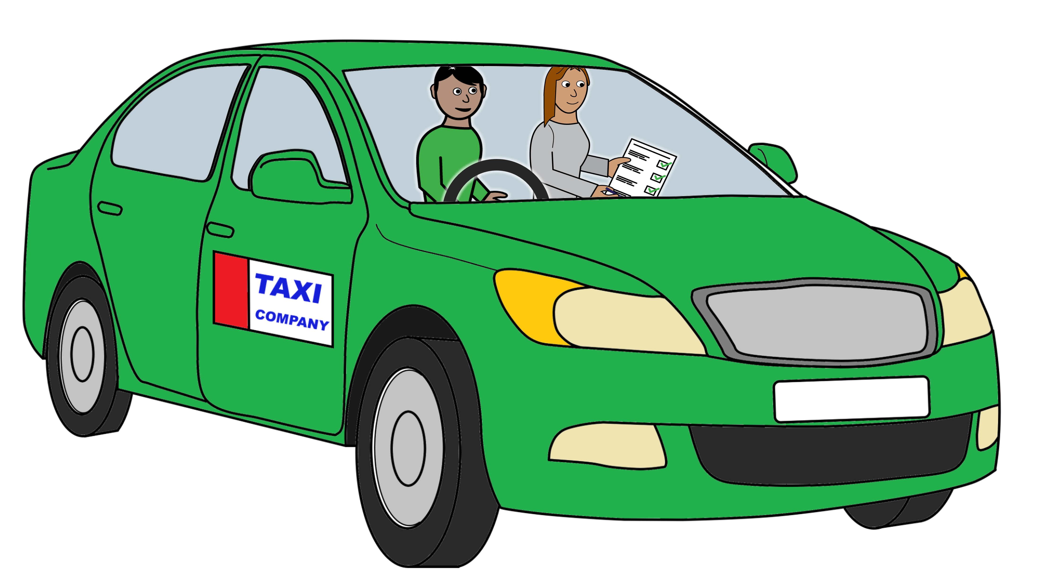
Leeds City Council has a team that says who is allowed to work as a taxi driver.
This is called taxi licensing.
They check people can drive safely.
They check people are safe to work with children, young people, and other people who might be vulnerable.
They check that the taxi car or van is safe to drive.
The team gives training to taxi drivers. This includes training about treating people fairly and with respect.
This training is given to new taxi drivers. And existing taxi drivers might have to do it if they are not following the rules.
Taxi Licensing
Safe to work
Taxi Licensing

Slide 4
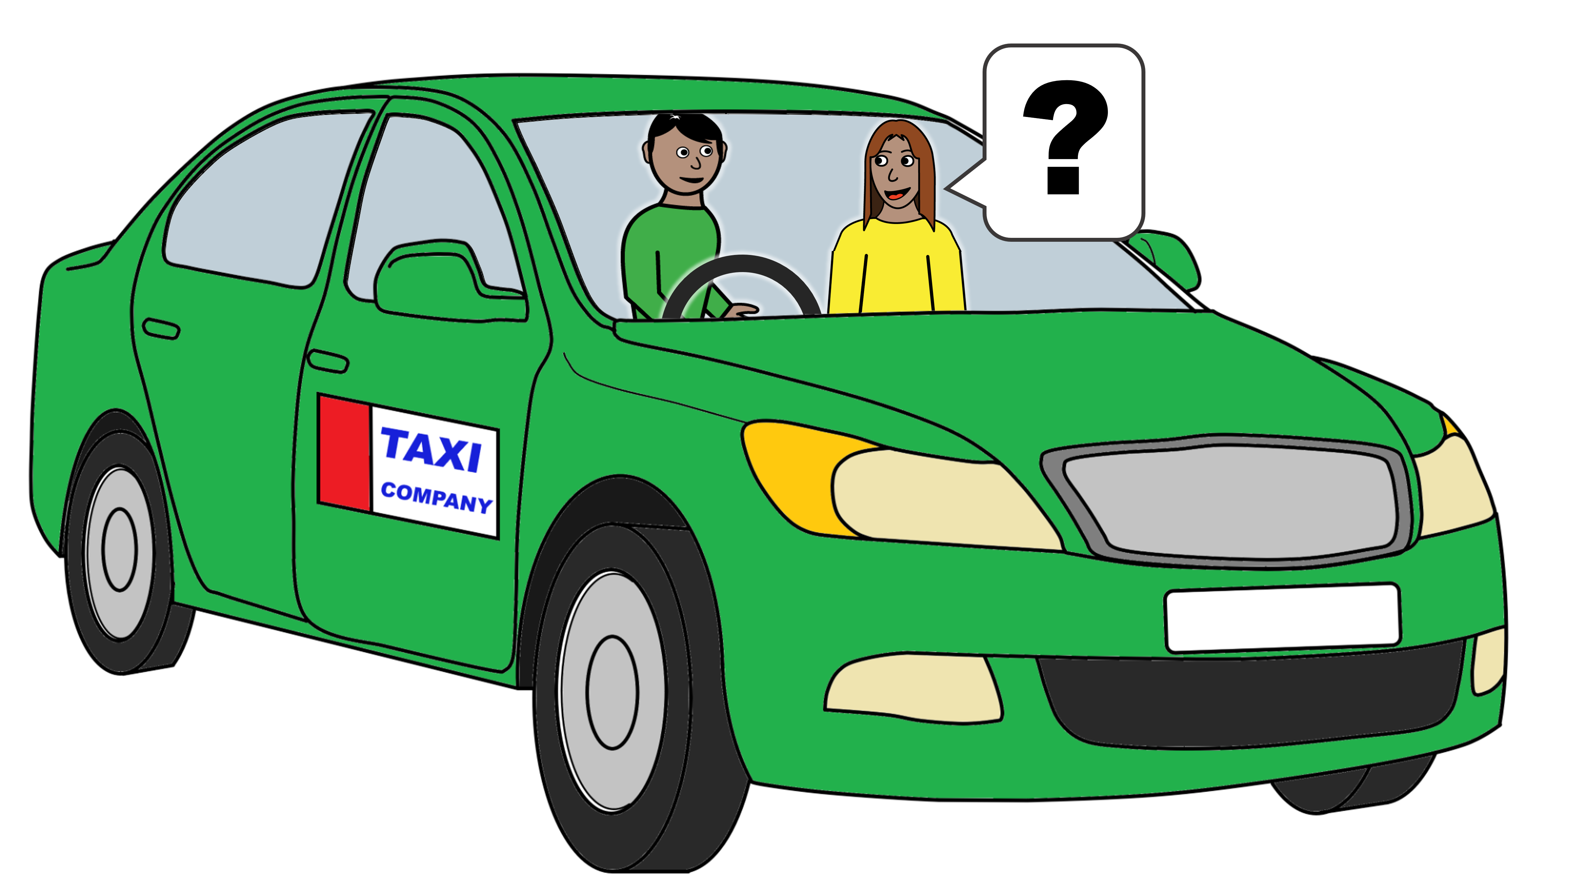
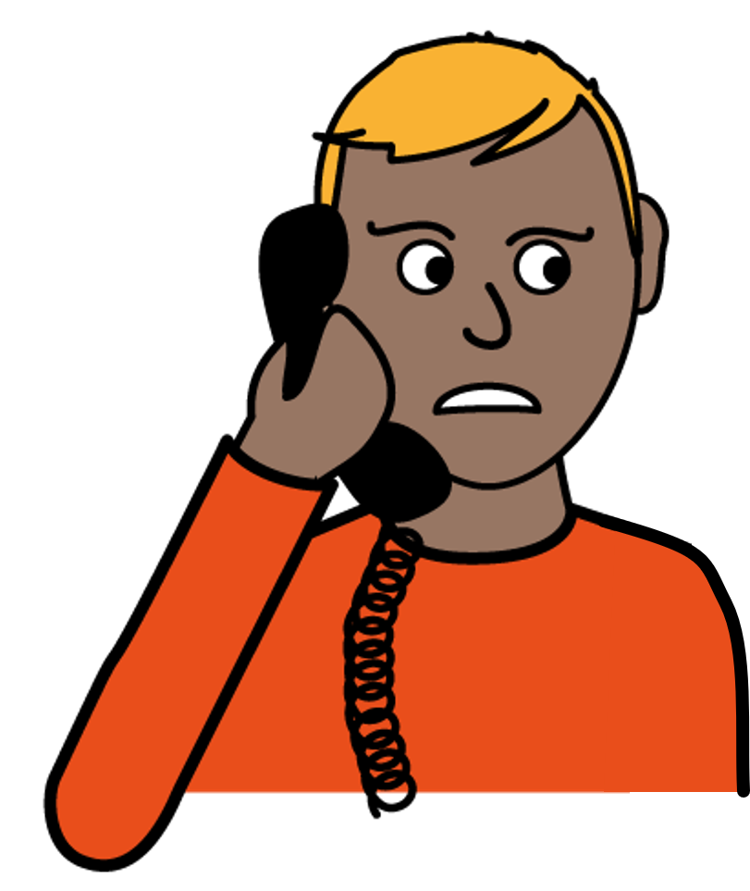
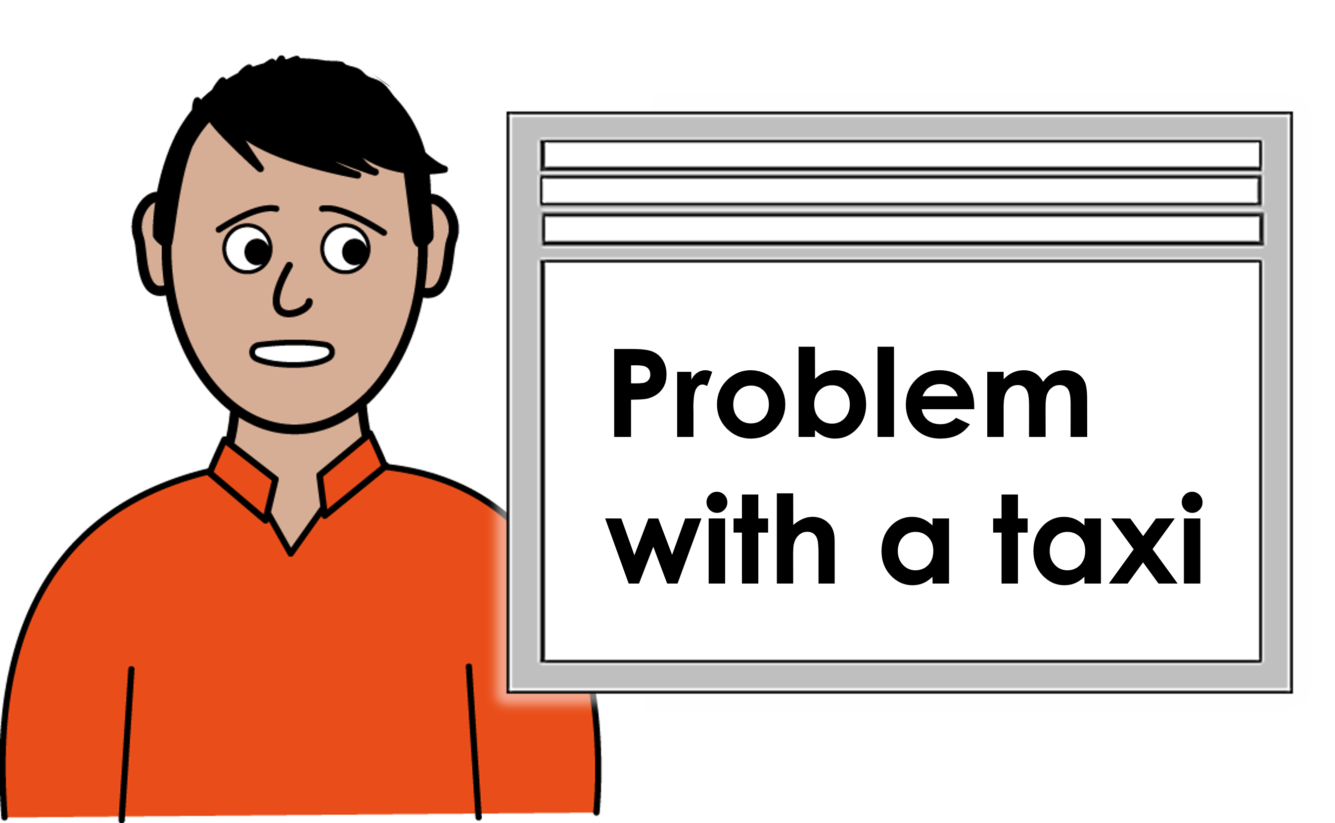
What if you have concerns or problems about taxis
If you feel it is okay to do so, you can talk to your taxi driver about any concerns. For example if you are not sure they are going the right way.
If you have concerns or problems you can talk to the taxi company. For example if you want to report that a taxi driver has treated you unfairly.
If the taxi company do not help with your concerns or problems you can contact the taxi licensing team.
Use this email address:
When reporting concerns and problems, get the taxi licence number.
This is shown on the sign on the door of the taxi and on the taxi windscreen.
Taxi Company
Taxi Licensing
taxiprivatehire.licensing@leeds.gov.uk
This leaflet was made by

